Slide 1
Grant seeking
Megan Hennessey-Greene, Director of Research Administration, Office of Research Administration
Ben Jones, Dir. of Corp. Engagement & Inst. Partnerships, Advancement

Slide 2
Agenda
Introductions and Overview
Who we are, how we can help
Seeking private funding - Ben
Seeking federal funding - Megan
Q&A

Slide 3
Differences between funding sources
Foundations
Corporations
Pros More of them Generally easy to apply Often less reporting requirements | Cons More competition Smaller awards Limited indirect (need to build out your budget to include) Limited to no feedback
Pros Can provide career of funding Generally more informal approach | Cons IP can be complex Hard to get in Interested in applied vs. basic

Slide 4
Office of Research Administration
Megan Hennessey-Greene, CRA
Director of Research Administration
Office of Research Administration
mhennesseygreene@umassd.edu
https://www.umassd.edu/research/research-administration

Slide 5
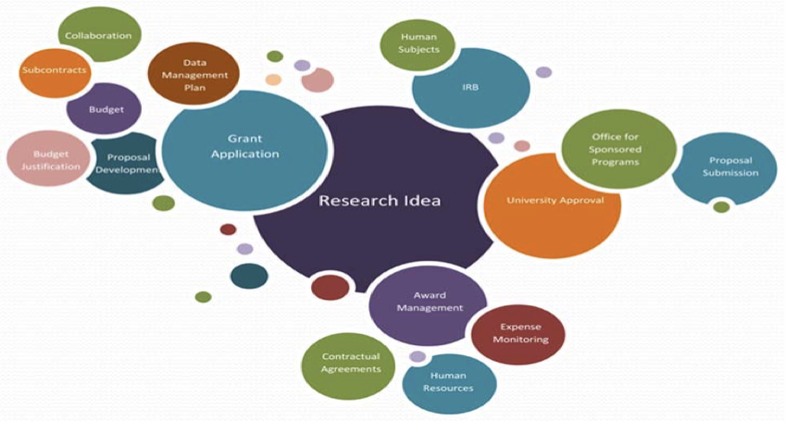

Slide 6
What is Research Administration?
Dissemination of funding opportunities
Communication of policies and processes
Proposal submission
Award negotiation
Award management
Compliance
Close out
Effort commitment and certification
The goal of ORA is to enhance faculty and staff success in obtaining external funding for research, training, and service activities, and to assist in the management of sponsored awards.

Slide 7
Lifecycle of an Award

Slide 8
Thinking about submitting?
Contact ORA Pre-Award as soon as you discover a grant funding opportunity
Read the entire RFP/RFA/Funding notice
Determine any registrations that may be needed well in advance
Assistance available from Research Support with budget templates, budget justifications, bio sketches, current and pending support listings

Slide 9
Proposal preparation and submission at UMassD
http://umassd.cayuse424.com/
Cayuse is a system-to-system software program for preparing, reviewing, approving, and submitting federal grant applications electronically.
Proposals are created in Cayuse and uploaded to grants.gov through Cayuse.
ORA will set up your user account and create a professional profile template for you. You will then complete the fields in the professional profile.

Slide 11
Pre & Post-award Assignments by College, Department & Program
Departments & Programs | Pre-award Contact for Proposals & Awards | Post-award Contact for Grants Management
Academic Resource Center | Michelle Plaud | Rebecca Harrison
Center for Innovation & Entrepreneurship | Deborah Dolan | Rebecca Harrison
Charlton College of Business | Michelle Plaud | Rebecca Harrison
College of Arts & Sciences (CAS) | Deborah Dolan | Rebecca Harrison
CAS: Kaput Center, Public Policy STEM Ed & Teacher Development | Deborah Dolan | Rebecca Harrison
College of Engineering | Michelle Plaud | Rebecca Harrison
College of Nursing | Deborah Dolan | Rebecca Harrison
College of Visual & Performing Arts (CVPA) | Michelle Plaud | Rebecca Harrison
Economic Development | Michelle Plaud | Rebecca Harrison
Law School | Michelle Plaud | Rebecca Harrison
Provost's Office | Michelle Plaud | Rebecca Harrison
School for Marine Science & Technology (SMAST): Department of Fisheries Oceanography (DFO), Department of Estuarine & Ocean Sciences (Coastal Systems) | Michelle Plaud | Rebecca Harrison
SMAST: Department of Estuarine & Ocean Sciences (DEOS) | Deborah Dolan | Rebecca Harrison
Student Affairs | Michelle Plaud | Rebecca Harrison
Upward Bound | Michelle Plaud | Rebecca Harrison

Slide 12
ORA Pre & Post Award Points of Contact
Pre-Award
Michelle Plaud
Manager, Pre-Award Administration
mplaud@umassd.edu
Post Award
Becky Harrison
Post Award Grant Manager
rebecca.harrison@umassd.edu
Josette Cormier (new hire 2/21)
Post Award Grant Manager
jfernandes2@umassd.edu

Slide 13
Resources
Funding: GrantForward PIVOT for funder research Foundation Center Grant Research Basics Guidestar (for 990 review) | Jobs: UMass Dartmouth Handshake Science Careers | Research resources: UMass Dartmouth Office of Research Administration

Slide 14
How we can help

Slide 15
Contact information
Megan Hennessey-Greene, Director of Research Administration
mhennesseygreene@umassd.edu, 508-910-6958
Ben Jones, Director of Corporate Engagement and Institutional Partnerships
ben.jones@umassd.edu, 508-209-3711

