Slide 1

Grant Seeking Basics - From Idea to Ask

Slide 2

What’s the Problem?

Slide 3

Who benefits?

Slide 4
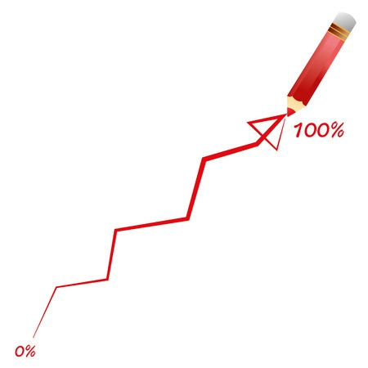
How will you measure your results?

Slide 5

When will you do the work?

Slide 6

Why you and why now?

Slide 7

How much will it cost?

Slide 8

How much do you need from us?

Slide 9

Why should I care?

Slide 10
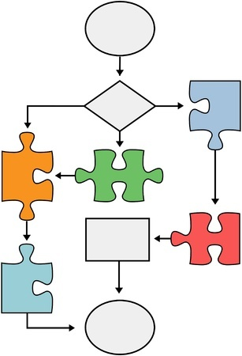
Process makes perfect

Slide 11

How C&F can help.

Slide 12
Resources
GrantForward
Foundation Center Proposal Writing Short Course
Foundation Center Grant Research Basics
Guidestar (for 990 review)

Slide 13
Agenda
Welcome and Introductions
Steps to a successful proposal
Process and Tools
How Corps & Founds Office can help
Q&A

