Slide 1
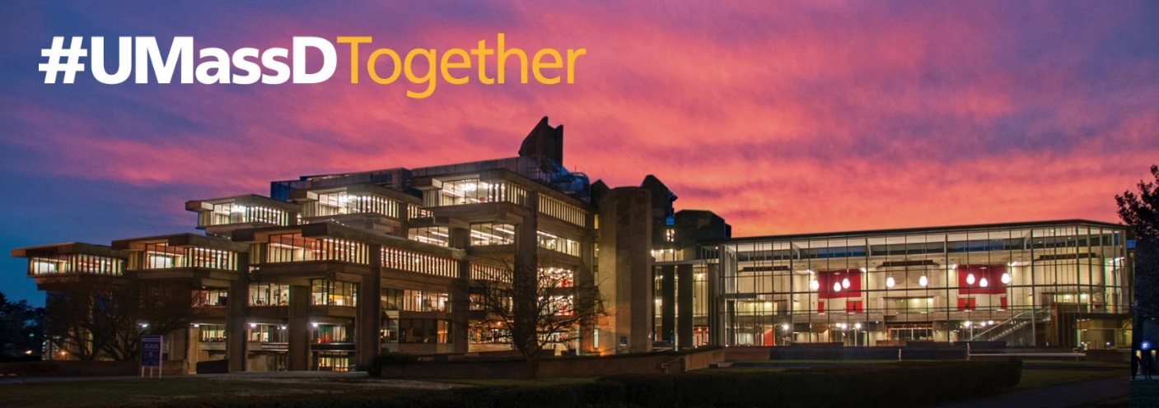
F-1 Student
Regulations
International Student & Scholar Center (ISSC)
What is the ISSC?
New Student Check In
Important Documents
Maintaining F-1 Status
SEVIS
Communicating with ISSC

Slide 2
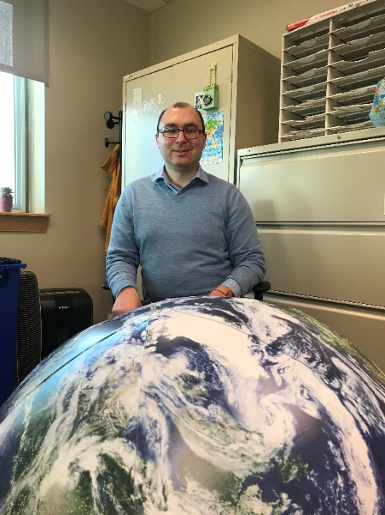
International student & Scholar center (ISSC)
Daniel Pirbudagov
Executive Director of International Education
Meghan Houghton
Associate Director, ISSC
Pat Mooney
Admin. Assistant II, ISSC
Judite Fernandes
Admin. Assistant I, ISSC
ISSC Student Team: Danish Abid, Aadit Yadav

Slide 3
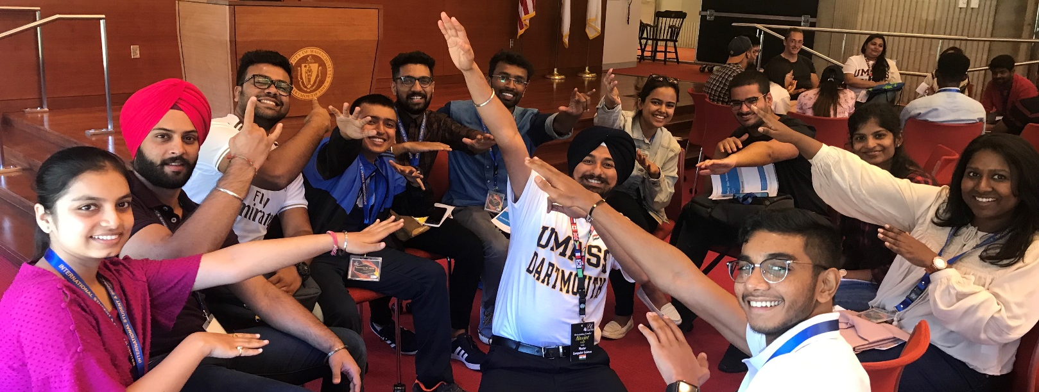
Services offered by the ISSC:
Provide support for visas and other immigration forms as well as required documentation for international students and scholars while in the US.
Provide Orientation for new international students.
Provide general advice and assistance with campus life and personal needs.
Offer workshops on employment and hot topics.
Co-sponsor cultural events with other organizations on campus.

Slide 4
Required “Check in”
All new international students are required to “CHECK IN” with the ISSC upon arrival to the US (or transferring from another university within the US)
You will receive an eForm link (to your UMassD email) TODAY notifying you about this requirement
The eForm will require you to upload your documents: F-1 Visa, I-94 Record, Entry Stamp
Deadline to submit CHECK IN eFORM: September 9th

Slide 5
Important documents for the f-1 student:
A valid passport from your country of citizenship.
A valid F-1 visa (valid upon entering US)
SEVIS Form I-20
I-94

Slide 6
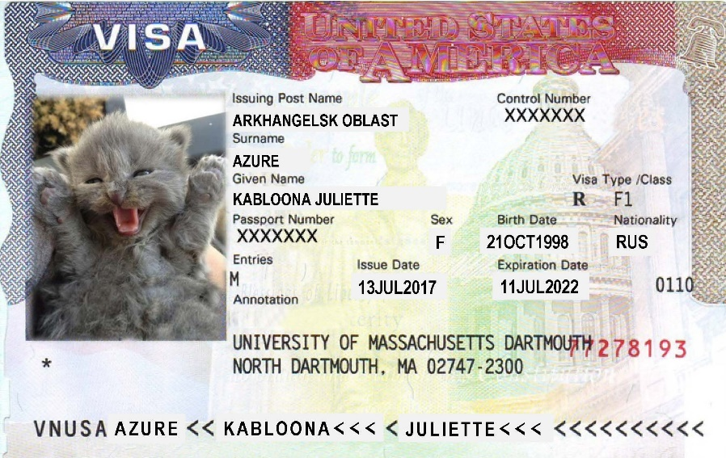
F-1 Visa
The visa is the actual document in your passport. It is authorization from the US Department of State to present yourself at a port or point of entry to the United States and request admission to enter the US in a particular status.
The F-1 visa indicates that you wish to enter the US as a “student” and that you plan to participate in only “student” activity.

Slide 7
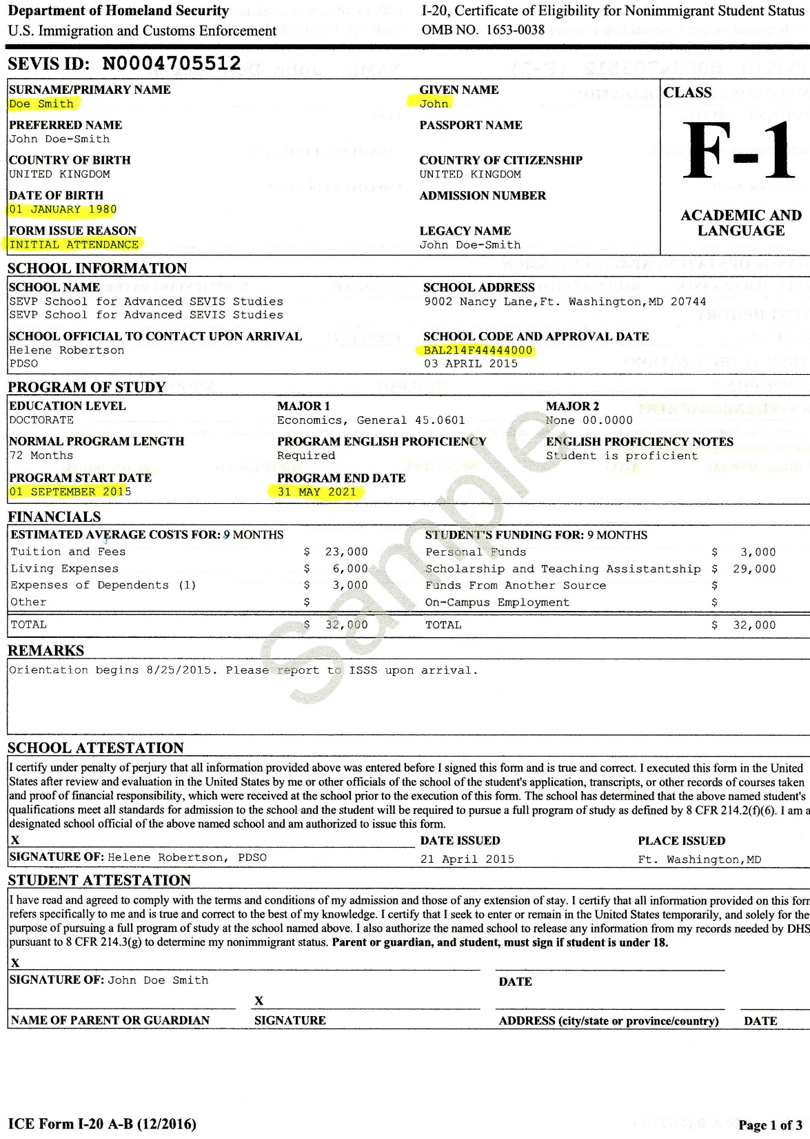
I-20 Page 1:

Slide 8
I-20 Page 1 continued:

Slide 9
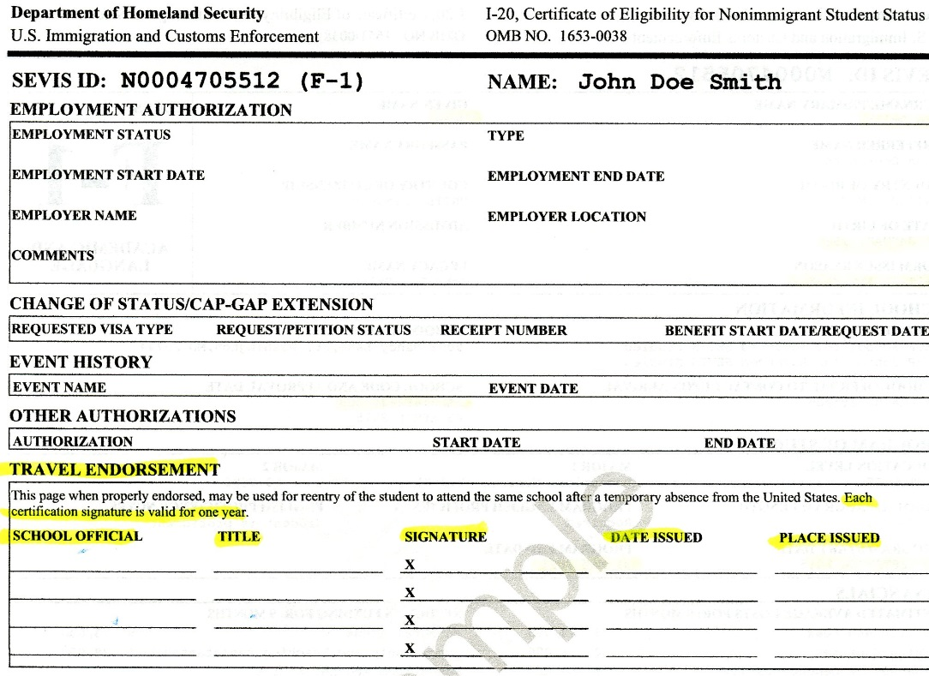
I-20 Page 2:

Slide 10
I-94
Please make sure your I-94 indicates that your class of admission is: F1

Slide 11
F-1 Student status
Status refers to the actual activity for which a person has been admitted to the United States.
In the case of F-1, that activity or status is “student.”

Slide 12
Duration of Status (D/S)
The student is admitted to the United States for “duration of status (D/S)” defined as:
the time during which the student is pursuing a full course of study at an educational institution
and the student’s time spent engaging in authorized practical training following completion of studies
and the 60 day “grace period” to prepare for departure from the United States
The student is considered to be maintaining status if he or she is making normal progress toward completing a full course of study.
If you successfully complete an academic program and apply and are accepted to another academic program at the same school or to another educational institution then your status as student continues as long as you follow the guidelines for transferring from one degree program to another.

Slide 13
Maintaining status:
Once admitted to the United States in F-1 status, an international student must follow specific rules in order to maintain status.
Maintain a valid passport at all times
Attend the school he/she was authorized to attend
…(continued on next slide)

Slide 14
Maintaining status (continued)
ENROLL IN A FULL TIME COURSE LOAD EVERY SEMESTER
Full Time for Undergraduate & Law Students =
12 credit minimum
Full Time for Graduate Students =
9 credit minimum

Slide 15
Maintaining status (continued)
What is the Program End Date on your I-20?
A program extension is required if you must remain in the United States in order to complete your degree after the “Program End” date on the most recent Form I-20. Information on this is available on our web site.
If your Program End date has expired or if you do not meet the other eligibility requirements for a program extension, you will need to immediately consult with the International Student & Scholar Center (ISSC).

Slide 16
Maintaining status (continued)
As an f-1 student, I must always:
Register full time every semester, ATTEND CLASSES
Take no more than one online class every semester
“Check-In” with the ISSC during the add/drop period EVERY SEMESTER!
Get passing grades, make normal progress towards completing my program or degree
Keep my I-20 current and accurate
Accept only ISSC-authorized off campus employment

Slide 17
Maintaining status (continued)
As an f-1 student, I must NEVER:
Work anywhere off campus without ISSC approval
Let my passport or I-20 expire
Stop going to class
Travel outside US without a valid travel signature
Forget to report change of US address within 10 days
Forget to “check-in” with the ISSC by the end of the add/drop period every semester

Slide 18
Maintaining status (continued)
What happens if I do not maintain F-1 status?
Failure to follow the regulations can result in loss of “status” which places the student’s presence in the U.S. in jeopardy.
Students must know and follow the regulations for their visa type.
The University is REQUIRED by law to report to SEVIS on your activities including failure to maintain status.
If you fail to maintain your status, then you will have to apply to USCIS for reinstatement, or in some cases, leave the U.S. and re-enter to establish legal status again. If you are expelled from the University for academic/behavioral reasons or worked without authorization, we cannot assist you with reinstatement.

Slide 19
EMPLOYMENT in F-1 status
New students with F-1 status may only work on campus. After you have been registered for a full academic year, you may be eligible to apply for off-campus employment (CPT or OPT).
Total number of hours worked per week cannot exceed 20 hours during the Fall and Spring semesters.
During the vacation periods (Summer, Winter, Spring Break) the total number of hours worked may be more than 20 per week.

Slide 20
EMPLOYMENT in F-1 status
International students are not eligible for “federal work-study” positions on campus.
International students may only work off-campus after one full academic year in your program with permission from the International Student & Scholar Center and/or USCIS.
CPT & OPT Workshops are scheduled every semester!

Slide 21
What is sevis?
SEVIS: Student and Exchange Visitor Information System
Since January of 2003, all international students who have required an I-20 have had an electronic record created in the database SEVIS.
All educational institutions who admit and enroll F, J or M visa students MUST, by law, use SEVIS.
SEVIS requires the University to report the activities of each student regularly.

Slide 22
What must the University report to sevis?
Withdrawal from classes!
(I-20 is terminated)
Your arrival
Your full time registration every semester!
Your US ADDRESS
Failure to maintain status
School transfer
Name change!
Leave of absence
Unauthorized work!
(I-20 Terminated)
Change of status
Authorized employment (CPT or OPT)
Pre authorized reduced course load
If you are not making progress towards completing your program
Add/Edit/Remove F-2 Dependent Information
Site of activity
Your phone #, email address
Visit http://www.umassd.edu/international_students for more information!
It is your responsibility to maintain status.

Slide 23
Reduced course load (rcl)
Academic Reasons
First Semester initial difficulties with English language, initial difficulties with reading, unfamiliarity with American teaching methods, improper course level placement
Final Semester of credit course work, including credit-bearing thesis registration
Medical Reason
Physical and/or mental health with medical documentation

Slide 24
Leaving the us
Wait…but I just arrived!
When your program is finished, for example, either when you complete your academic program requirements, or when you reach the end of your authorized post-completion practical training (OPT) you will enter your grace period and must be prepared to leave the country within 60 days. You may not work or study during the grace period.
You may not remain in the US after you complete your degree program (and the sixty days grace period) unless you have been authorized for post completion Optional Practical Training (OPT), are admitted and enroll in another UMass Dartmouth degree program, transfer to another institution, or change your status.

Slide 25
Leaving the us
If you must end your participation in the academic program because you are dismissed for academic or behavioral reasons, then you are no longer “in status.” In this case you must leave the U.S. immediately and are not eligible for the 60 day “grace period.”
If you fail to follow the regulations, fall out of “status” and you apply for reinstatement and are denied the request, you will be required to leave the U.S.
Prior to taking an academic leave of absence for personal or medical reasons from your program you must consult with the International Student & Scholar Center regarding your status.

Slide 26
Umass dartmouth email
We will contact you by emailing your UMass Dartmouth email address.
Only University emails are considered official forms of communication.
Please review your UMass Dartmouth email account daily!

Slide 27
Important communication
Contact us at:
INTL_Office@umassd.edu
We will contact you with important information from:
ISO@umassd.edu
Have a question? Need a form? Check our website:
www.umassd.edu/international_students/

Slide 28
Fall 2021: Issc operations
8 AM – 5 PM when University is open, by appointment only
One on One Advising Appointments
ISSC’s Virtual Advising Hour (Tuesdays at 2pm – See emails)
OPT & CPT Virtual Workshops

Slide 29
Please Remember…
CHECK IN eForm by Sept. 9
FULL TIME Enrollment (at least 1 blended or face to face class in Fall 2021)
Accurate local US ADDRESS in your COIN account (within 10 business days)

Slide 30
Questions?
International Student & Scholar Center (ISSC)
Email Us: intl_office@umassd.edu
Visit Us: http://www.umassd.edu/international_students/
Follow Us:
Snapchat @
ISSC_UMD
Instagram @
ISSC_UMD
Facebook @
International Student & Scholar Center -UMD

