Slide 1
Partners In Health
Presenter: Ana Sanchez-Junkin

Slide 2
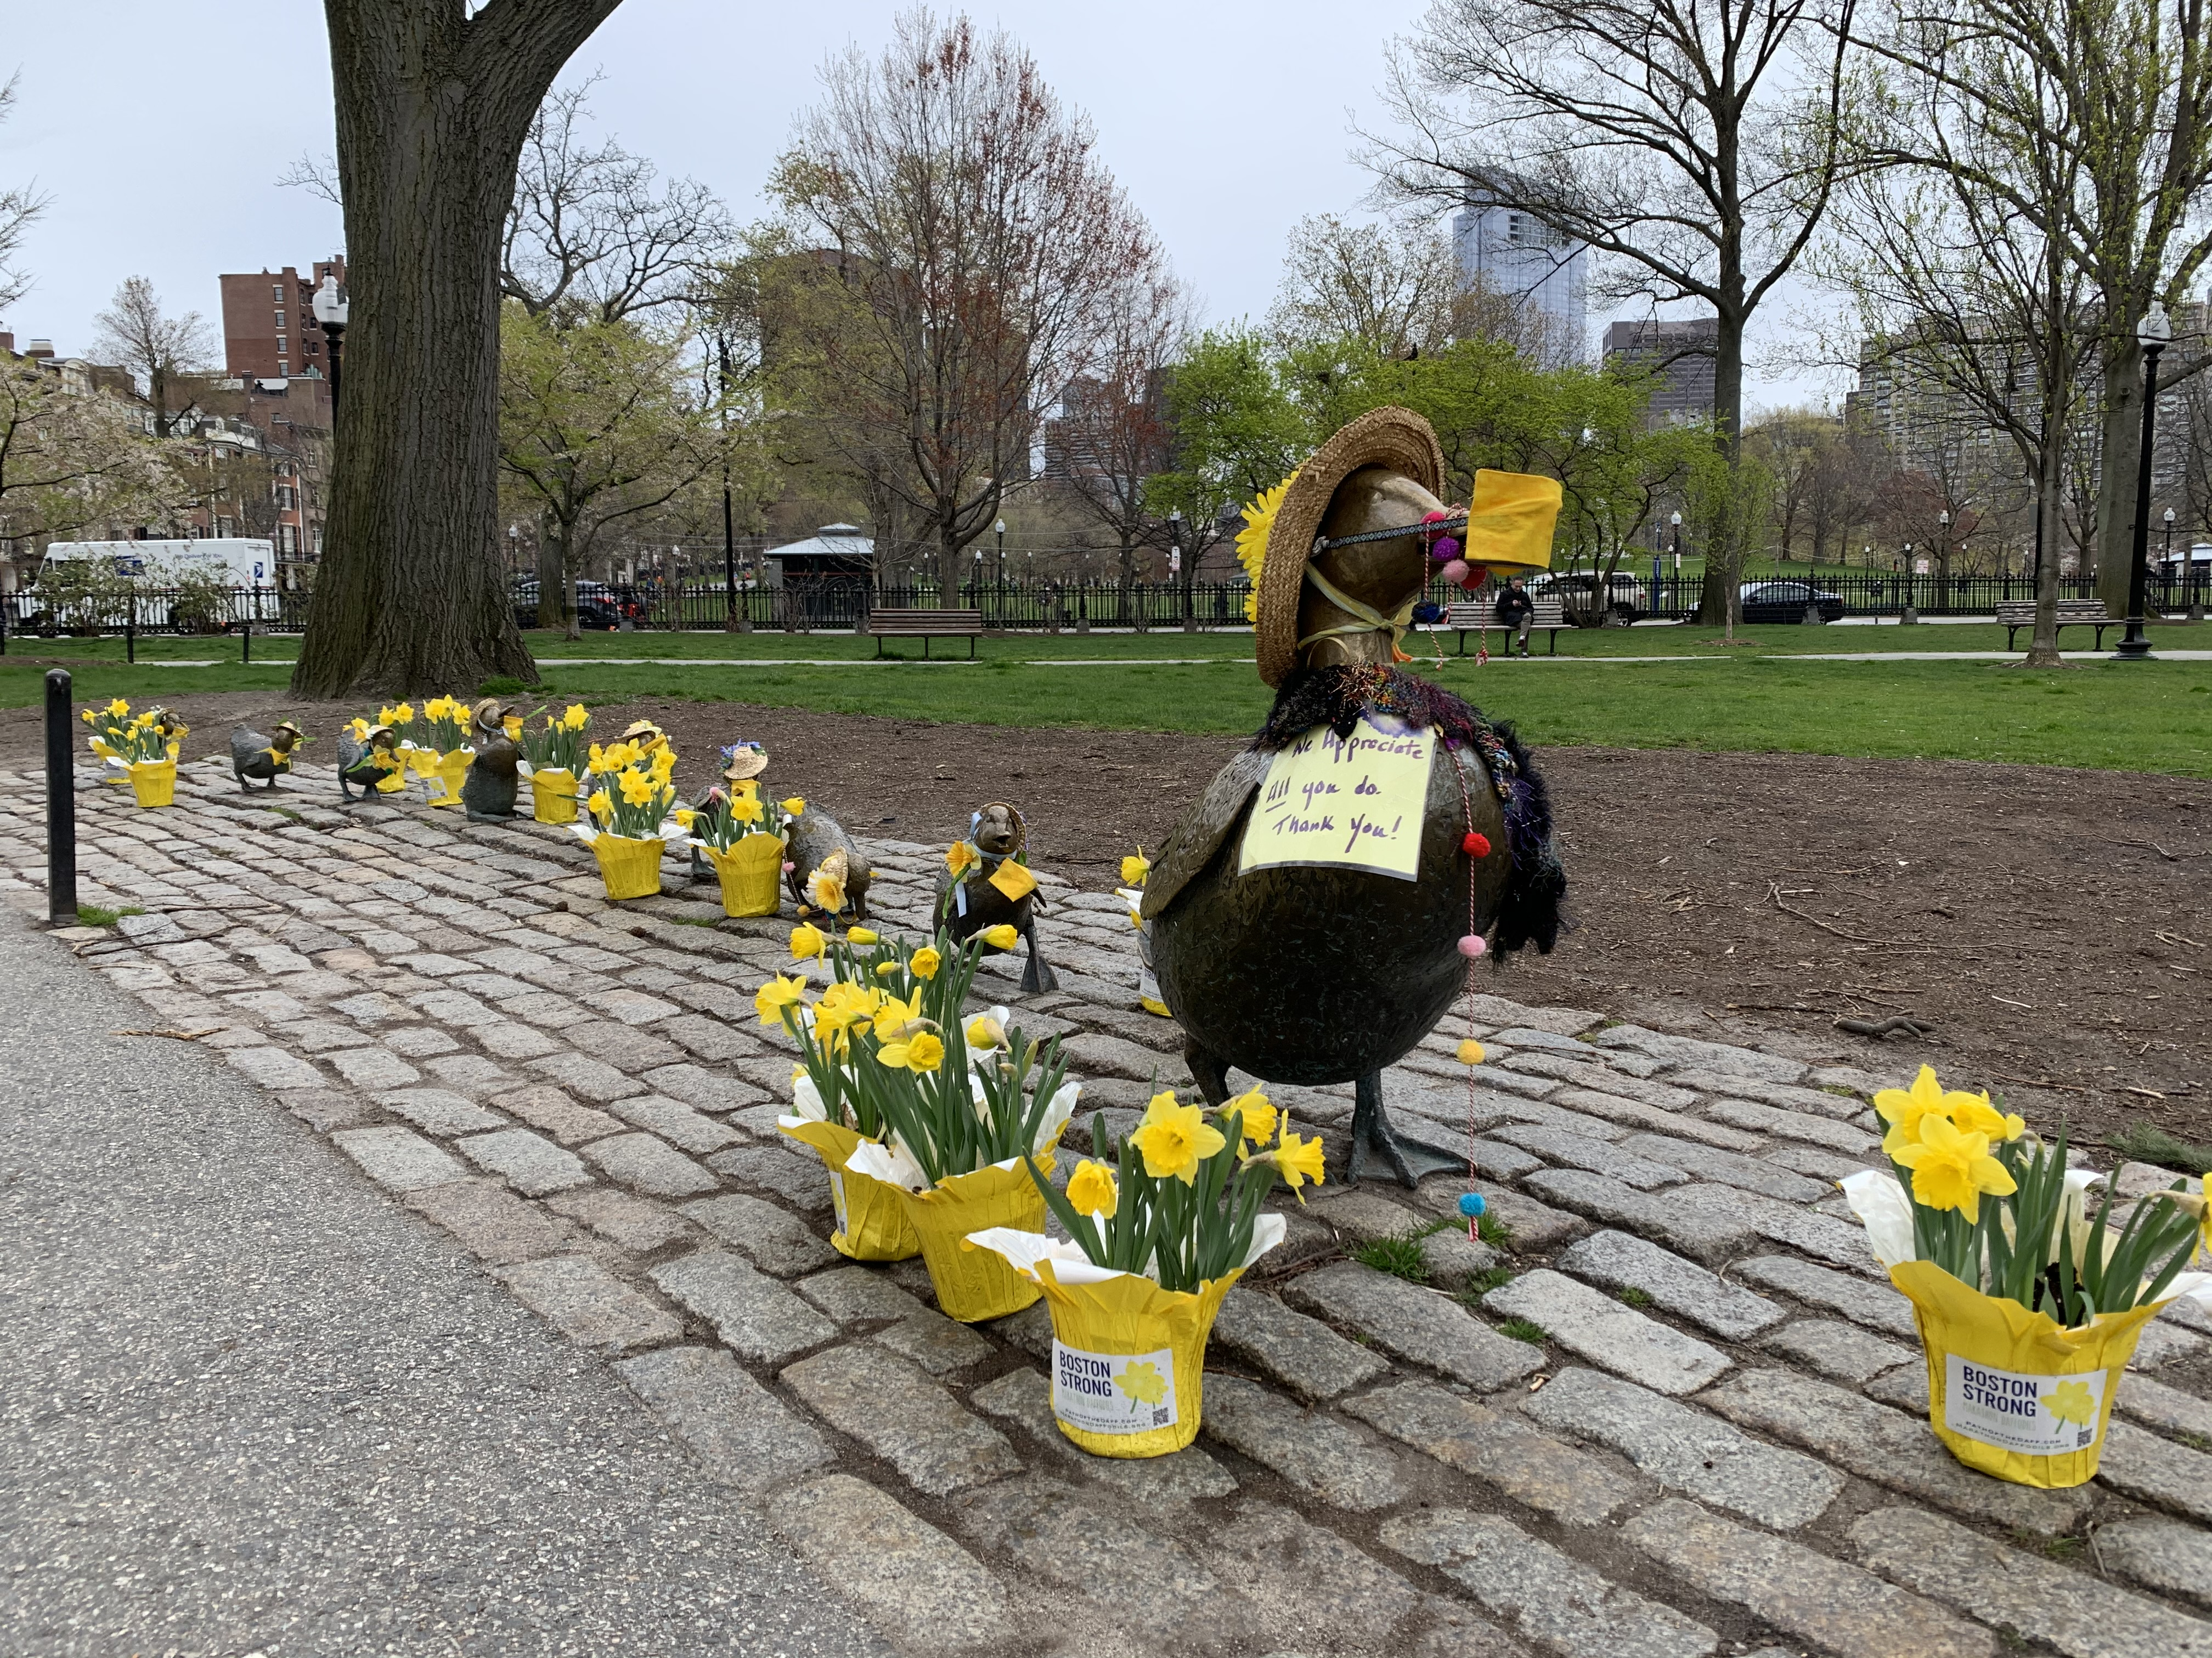

COVID-19 Contact Tracing in MA
What is contact tracing and why is it important?

Slide 3
Objectives
Help you understand what the Community Tracing Collaborative is.
01
Help you understand what contact tracing is and why it is important.
02
Explain what you can expect if you receive a phone call from the MA COVID Team
03
Provide you with information to keep yourself and those you care about safe from COVID-19
04

Slide 4

What is the Community Tracing Collaborative?
It is a program in Massachusetts that was developed in the early months of the COVID-19 pandemic to support the local board of health departments in contact tracing.
The Community Tracing Collaborative (CTC) is a partnership between the Department of Public Health, Local Boards of Health, and Partners in Health.
The objective of the CTC is to slow the spread of the coronavirus and support people that need to self-isolate.

Slide 5
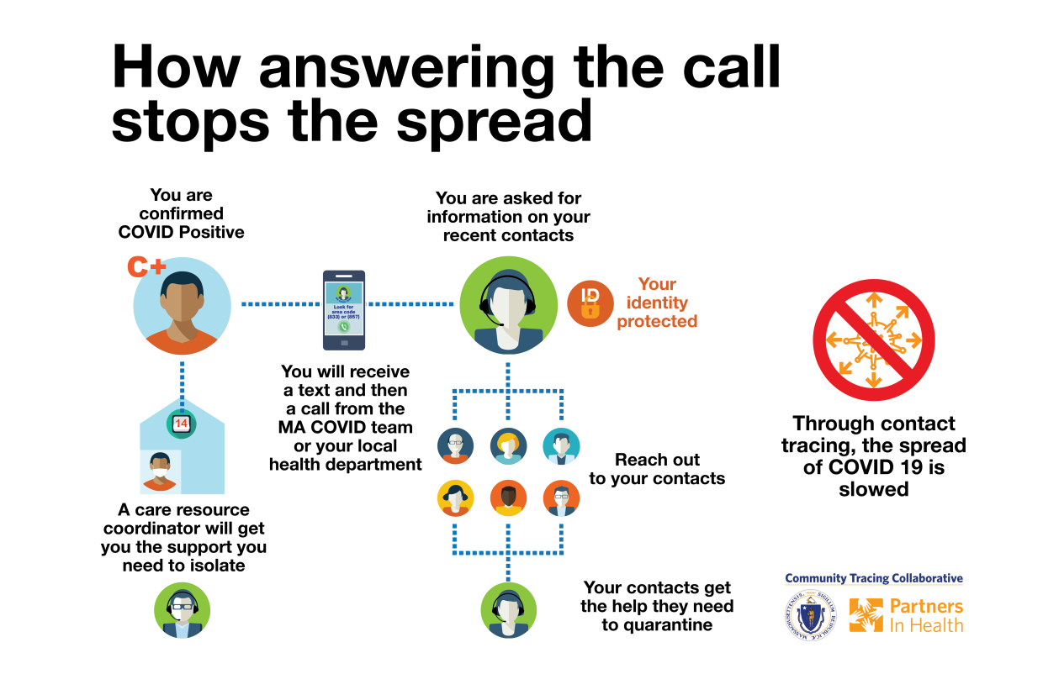
What is contact tracing?
When someone is diagnosed with COVID-19 they are contacted by our team to:
Ensure they can self-isolate safely
Collect contact info for people they had been with in the 48 hours prior to getting sick.
Their contacts receive a phone call to help them start a quarantine.

Slide 6

Why is contact tracing important?
COVID-19 is very contagious.
People who become sick with COVID-19 can spread it to others 2 days prior to them feeling sick.
By identifying people who have been exposed to the virus and helping them quarantine (i.e. stay home and not leave unless it is a medical emergency), we can stop the spread of the virus.

Slide 7






SUNDAY | MONDAY | TUESDAY | WEDNESDAY | THURSDAY | FRIDAY | SATURDAY
Incubation
Infectious
Infectious
Incubation
Self-isolation
Infectious
Self-isolation

Slide 8
SUNDAY | MONDAY | TUESDAY | WEDNESDAY | THURSDAY | FRIDAY | SATURDAY
Incubation
Infectious
Infectious
Incubation
Self-isolation
CONTACTS
Infectious
Self-isolation

Slide 9

What can I expect from the phone call if I have been exposed to someone with COVID-19?
Your contact information will be confirmed.
Demographic information will be completed.
You will be instructed on a quarantine period (stay at home).
You will be provided with information on places where you can go get tested.
If needed and desired, you can be referred to Care Resource Coordinator who can help you safely quarantine.
You can request a letter to send to your employer stating you are in quarantine.

Slide 10
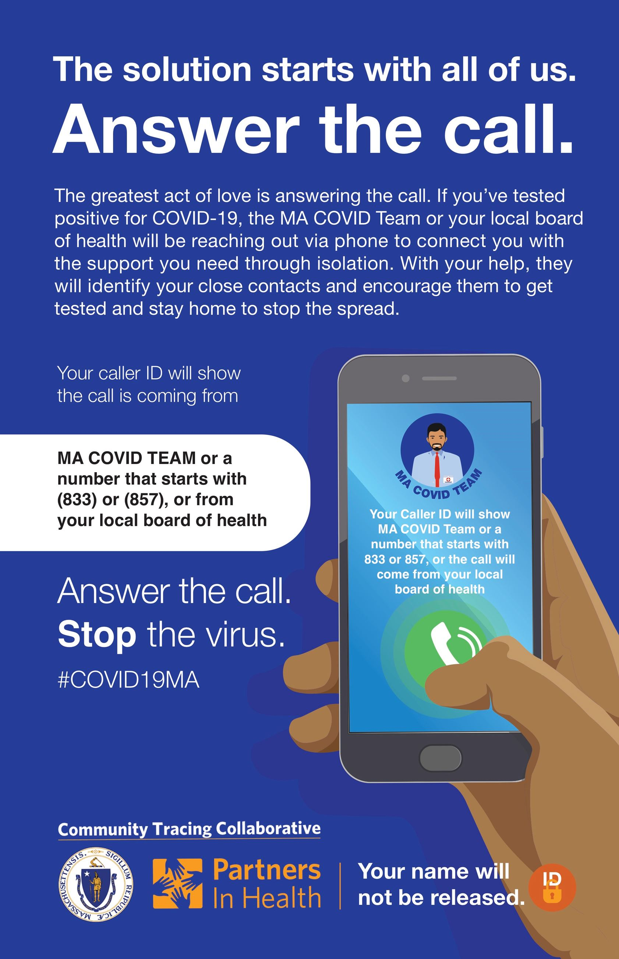
What can I expect from the call if I have been diagnosed with COVID-19?
Your information will be confirmed (DOB, name, and address).
Talk about the symptoms that you are experiencing
Ask you questions to try to figure out together where you were exposed to the virus.
Collect the contact information of people you were in contact 48 hours prior to developing symptoms.
Give you instructions on how to self-isolate and offer referral to a care resource coordinator.
Provide you with options for follow-up.
Can provide you with a letter to send to your employer to let them know you need to quarantine.

Slide 11
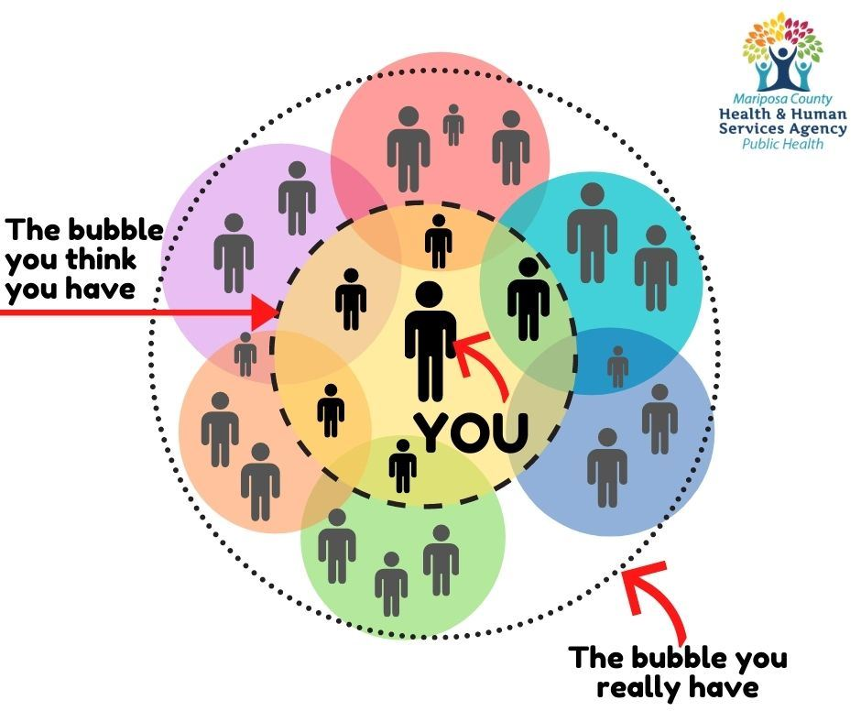

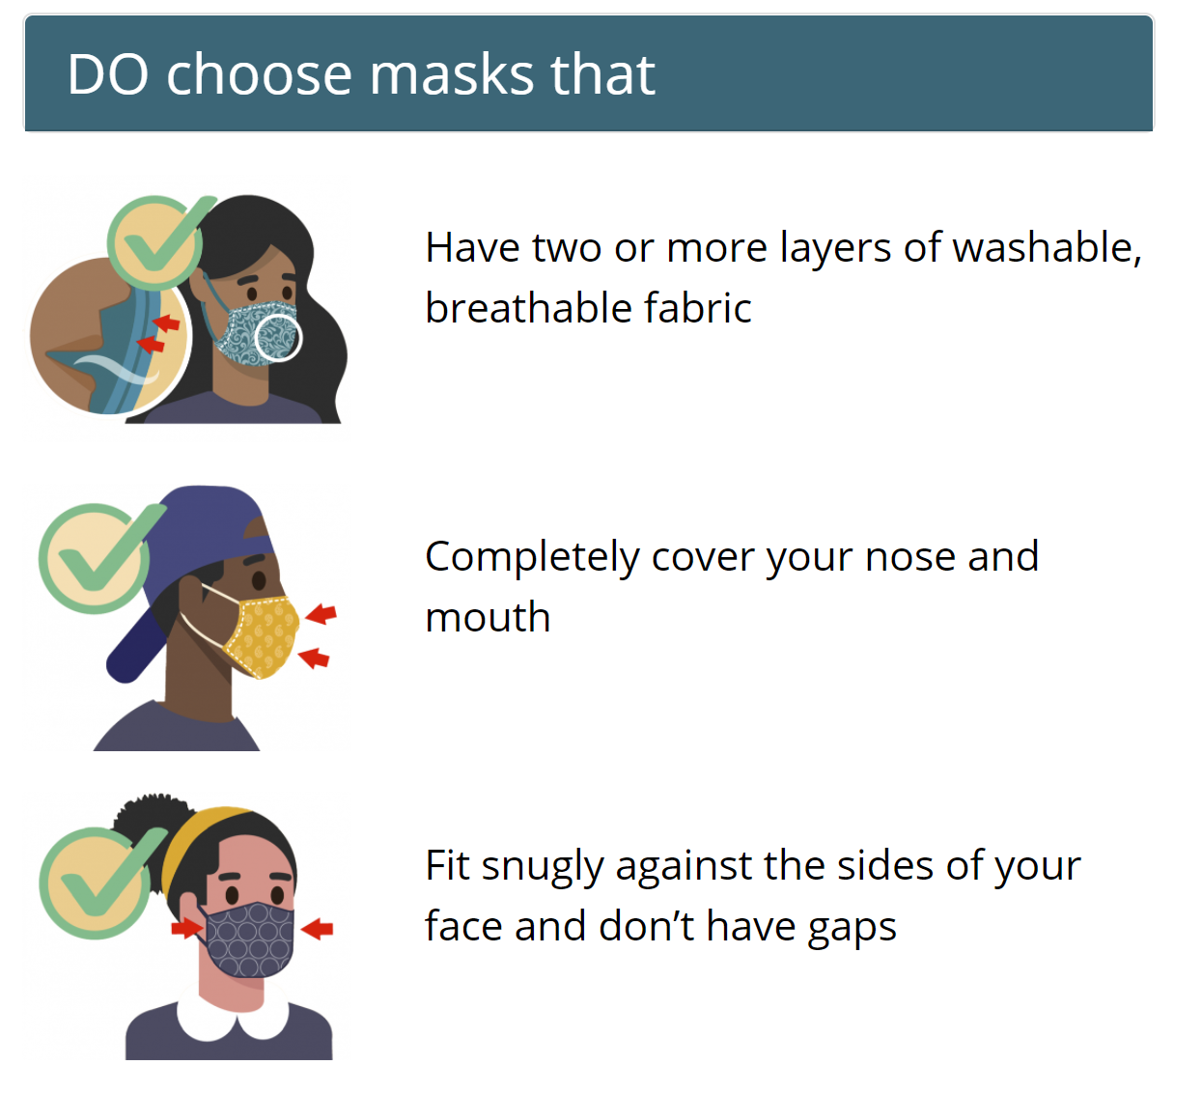
How can I keep myself and my loved ones safe from COVID-19?
Notes:
Images from:
https://www.mariposacounty.org/1592/COVID-19-Information
https://www.cdc.gov/coronavirus/2019-ncov/daily-life-coping/holidays/winter.html

Slide 12
New Bedford Health Department
Presenter: Damon Chaplin

Slide 13
MassCOSH (Massachusetts Coalition for Occupational Safety and Health)
Presenter: Jodi Surgerman-Brozan & Tish Davis

Slide 14

COVID-19 WORKPLACE SAFETY PROTECTIONS IN MASSACHUSETTS

Slide 15
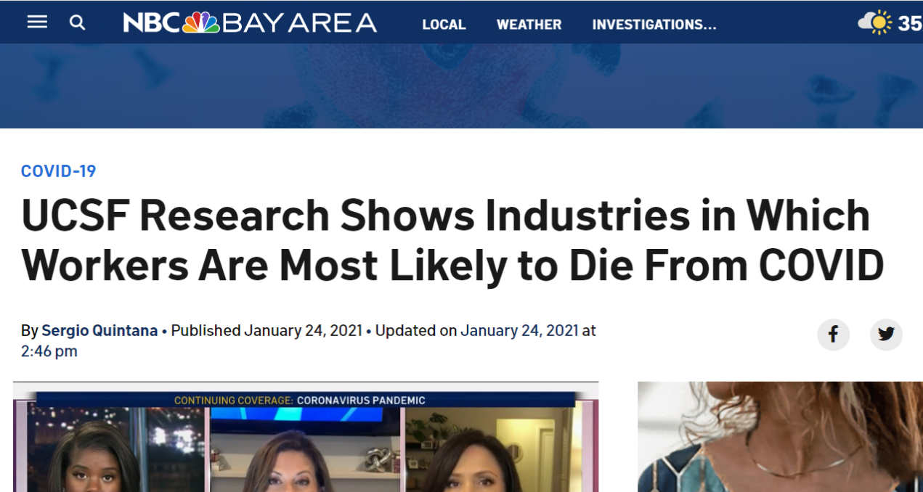
Food/agriculture workers (including restaurant workers): 39%
Transportation/logistics workers: 28% increase
Facilities: 27%
Manufacturing workers: 23%
Latino Californians experienced a 36% increase in mortality, with a 59% increase among Latino food/agriculture workers.
Black Californians experienced a 28% increase in mortality, with a 36% increase for Black retail workers.
Asian Californians experienced an 18% increase, with a 40% increase among Asian healthcare workers.
Excess mortality among White working-age Californians increased by 6%, with a 16% increase among White food/agriculture workers.
Using death records from the California Department of Public Health, they estimated excess mortality among Californians 18–65 years of age by occupational sector and occupation. During the COVID-19 pandemic, working age adults experienced a 22% increase in mortality compared to historical periods.

Slide 16
In Massachusetts we may never know the full impact COVID-19 has had on workers because the State has failed to collect data on the occupation, industry and employers of those that have become ill or died from the virus. We have to rely on other data that demonstrates the impact.
Worker complaints to the State and OSHA – tens of thousands.
As of August 24, the Fair Labor Division at the Massachusetts Attorney General’s office has received 2,856 complaints via the online form rolled out on May 19.

Slide 17
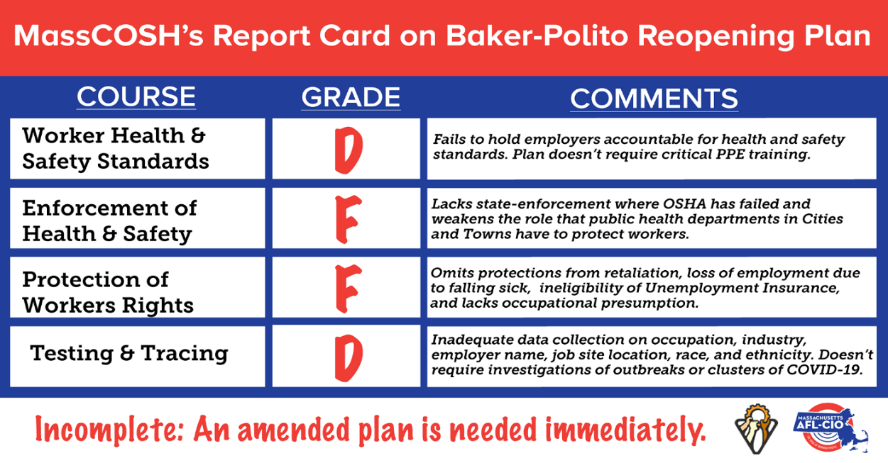
On May 11 MassCOSH released extensive, science-based recommendations to Baker’s Reopening Advisory Board:
Enforceable standards
Screening, testing, contact tracing, surveillance
Protect workers’ voice and job protections
Unfortunately, these recommendations were ignored by the Governor’s CEO-heavy Reopening Advisory Board. On May 18, as the State launched Phase 1 of reopening, MassCOSH gave the plan a report card with failing grades.
Reopening Massachusetts

Slide 18
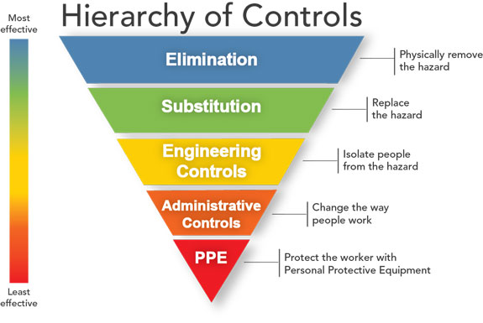
What protections do I need to be safe at work?
Source: NIOSH
Notes:
Rick

Slide 19
Evolution of Enforcement of COVID-19 Mandatory Safety Standards for Workplaces
The plan left enforcement mostly to Local Boards of Health (LBOH) without providing any additional support or capacity, and in some aspects, undermining LBOH’s authority to apply higher safety standards and/or close businesses that they believe are endangering workers and the public.
When the Reopening Plan failed to provide workers with any clear way to report and get assistance with unsafe work conditions, at the urging of the Labor Advisory Council, the Massachusetts Attorney General Fair Labor Division’s Office built on the hotline they had already created for essential workers to launch an on-line complaint form. That hotline closed in August.
Early in the pandemic, the Massachusetts Department of Labor Standards was tasked only with enforcement guidelines ensuring only that only those businesses allowed to open were open. As the State continued to reopen, DLS became more engaged in enforcement, and on July 13 launched their own complaint form. They now work in partnership with LBOH to enforce standards and promulgated temporary emergency regulations to allow for that enforcement.
Notes:
Jodi

Slide 20
What is required by the Regulations?
Social Distancing: Your employer must establish protocols and provide signage to ensure that you can remain at least 6 feet apart from all other persons including workers, customers and vendors.
Handwashing: Your employer must provide opportunities for frequent hand-washing, adequate supplies to do so, and hand-washing capabilities throughout the workplace.
Face coverings: Your employer must require face coverings or masks for all workers. The regulations do not require that the masks be provided by your employer, however, the OSHA Personal Protective (PPE) Equipment standard requires that employers provide the appropriate PPE.
Cleaning and Disinfecting: Your employer must establish and maintain cleaning protocols “specific to the enterprise. Disinfection of all common surfaces must take place at intervals “appropriate to said workplace.” If a worker is diagnosed with COVID-19, cleaning and disinfecting must be performed.

Slide 21
Training: Your employer must provide training for workers regarding COVID-19 safety which includes at least: signs and symptoms of COVID-19; risk of asymptomatic spread of COVID-19; employee and employer requirements under the COVID-19 Workplace Safety Regulations, including sector specific standards (see below). Training must also include information on anti-retaliation protections. Your employer must document this training and it must be provided at no cost to the employee and during working hours.
Sanitation: Your employer must provide regular sanitization of high touch areas, such as workstations, equipment, screens, doorknobs, and restrooms throughout the workplace. Note that sanitizing is generally a little more gentle than disinfecting. So while sanitizing refers to lowering the number of germs to a safe level by either cleaning or disinfecting, disinfecting itself refers to killing nearly 100 percent of germs on surfaces or objects, according to the CDC.

Slide 22
Notification of Positive Cases: If the employer is notified of any positive case at the workplace, the employer must immediately notify the Local Board of Health (LBOH) in the city or town where the workplace is located. Employers must cooperate with contact tracing and COVID-19 control instructions from the LBOH and the Department of Public Health or other designated public health authority. Department of Health guidance also requires that if an employee is confirmed to have COVID-19 infection, employers should inform fellow employees of their possible exposure to COVID-19 in the workplace but maintain confidentiality as required by the Americans with Disabilities Act (ADA).
Return to Work Plan: Employers must also create a plan to address workers who become ill from COVID-19 at work and a return-to-work plan, following guidance issued by the Massachusetts Department of Public Health found here on the Attorney General’s Website.

Slide 23
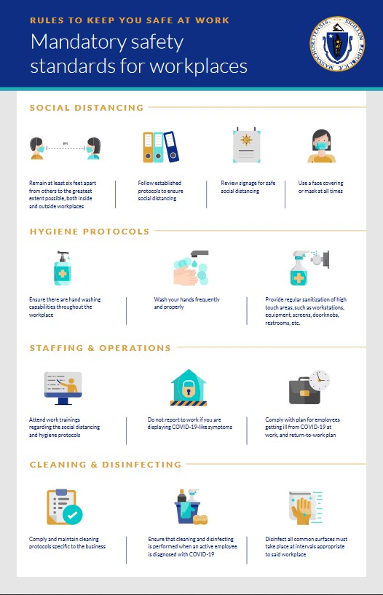
All businesses allowed to open have to self-certify that they meet the regulations.
To self-certify that they meet these standards, businesses must complete and post the following check-lists and posters:
COVID-19 control plan template
Compliance attestation poster
Employer and Worker posters found here.

Slide 24
Sector-Specific Rules: In addition to these regulations, there are “sector-specific rules” for the sectors listed below. Were the COVID-19 Workplace Safety Rules conflict with the Sector-Specific Rules, the Sector-Specific Rules apply.
arcades and other indoor and outdoor game and recreation businesses
close contact personal services
construction
drive-in movie theaters
driving and flight schools
fitness centers and health clubs
golf facilities
indoor and outdoor events
laboratories
libraries
Manufacturing
museums, cultural and historical facilities, and guided tours
office spaces
operators of lodgings
places of worship
restaurants
retail businesses
theaters and performance venues

Slide 25
However, these workers are exempt from the regulations:
Any health care facility or licensed health care provider
Public and private elementary and secondary (K-12) schools
Residential and day schools for special needs students
Licensed, approved, or exempt childcare programs and any emergency childcare centers and emergency residential programs operating under emergency authorization
Facilities operated by the Department of Correction or any Sheriff
Facilities operated, contracted or licensed by the Department of Youth Services, Department of Mental Health, Department of Public Health, or the Department of Developmental Services
Facilities that provide safe spaces for the unstably housed such as homeless and domestic violence shelters
Any other facilities or workplaces that the Commissioner of Public Health has exempted in writing

Slide 26
If you would like to report that your employer is non-compliant with these regulations or the sector-specific rules, reach out to your Local Board of Health (LBOH).
You may also report non-compliance to the Department of Labor Standards (DLS) through their hotline (508) 616-0461 x 9488, by completing this online form, or by sending an email to safepublicworkplacemailbox@mass.gov.
Inspections: When they receive a complaint, the department or the LBOH will review the complaint to determine if further action like an inspection is warranted. If the Department of Labor Standards or the Local Board of Health conduct an inspection, a representative of the employer and a representative authorized by the workers shall be given an opportunity to accompany an authorized inspector during the physical inspection of any workplace.
Penalties: Businesses that don’t comply with these regulations can be issued a civil fine of up to $300 per violation per day. However, the Department of Labor Standards or Local Boards of Health can issue a verbal or written warning prior to issuing a fine. The Department of Labor Standards can also issue a cease and desist letter, file an injunction to enforce compliance, or request the assistance of state and local law enforcement authorities if a compliance issue presents an immediate threat to health and safety or a risk of confrontation.

Slide 27
OSHA does provide some regulatory protections, which through the Public Sector OSHA law, are also provided to public sector workers in MA. These regulations are enforced by the Department of Labor Standards
The General Duty Clause, Section 5(a)(1) of the Occupational Safety and Health (OSH) Act of 1970, 29 USC 654(a)(1), requires employers to furnish to each worker “employment and a place of employment which are free from recognized hazards that are causing or are likely to cause death or serious physical harm.”
OSHA’s Personal Protective Equipment (PPE) standards (in general industry, 29 CFR 1910 Subpart I) require using gloves, eye and face protection, and respiratory protection where needed. Click here to read the full text of the standards.
When respirators are necessary to protect workers or where employers require respirator use, employers must implement a comprehensive respiratory protection program in accordance with the Respiratory Protection standard (29 CFR 1910.134).
OSHA’s Bloodborne Pathogens standard (29 CFR 1910.1030) applies to occupational exposure to human blood and other potentially infectious materials that typically do not include the kind of respiratory secretions that could transmit coronavirus. However, the provisions of the standard offer a framework that may help control some sources of the virus, including exposures to body fluids (e.g., respiratory secretions) not covered by the standard. See: www.osha.gov/laws-regs/regulations/standardnumber/1910/1910.1030.
OSHA’s Sanitation standard (29 CFR 1910.141 for general industry, and 1926.51 for construction) requires workplaces to have sufficient, sanitary bathrooms that are accessible and available to workers whenever necessary. An employer cannot forbid you from using the bathroom and cannot assign you so much work that you do not have time to use the bathroom. See: https://www.osha.gov/SLTC/restrooms_sanitation/

Slide 28
Right to Report and Right to Refuse Dangerous Work
You have a right to report if your workplace is unsafe during the COVID-19 pandemic (and always). You also have the right to refuse dangerous work that puts you at risk of death or serious physical harm. However, in order to be legally refuse to do dangerous work, the following things must be true:
Where possible, you have asked the employer to eliminate the danger, and the employer failed to do so; and
You refused to work in "good faith." This means that you must genuinely believe that an imminent danger exists; and
A reasonable person would agree that there is a real danger of death or serious injury; and
There isn't enough time, due to the urgency of the hazard, to get it corrected through regular enforcement channels, such as requesting an OSHA inspection.
If all of these things are true, then you should:
First ask your employer to correct the hazard, or to assign other work;
Tell your employer that you won't perform the work unless and until the hazard is corrected; and
Remain at the worksite until ordered to leave by your employer.
Visit OSHA’s page about the Right to Refuse for more information.

Slide 29
The Department of Labor Standards has opened 1,422 business cases.
648 have resulted in violations (45%)
502 have resulted in no violations (35%)
56 have resulted in Cease and Desist Orders (4%)
The Contact Tracing Collaborative has asked the Department of Labor Standards to investigate 74 cluster in Massachusetts. The most impacted industry is food processing
(12 of the clusters).

Slide 30
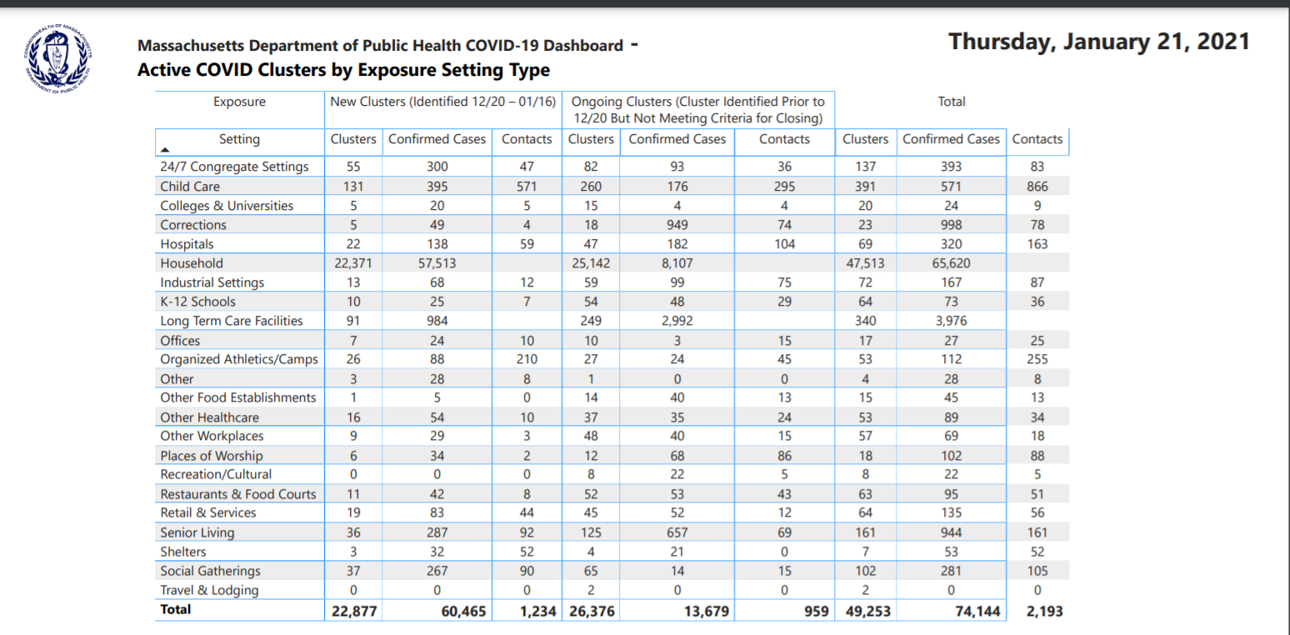

Slide 31
Union Workers are Safer: Organizing gets the Goods

Slide 32
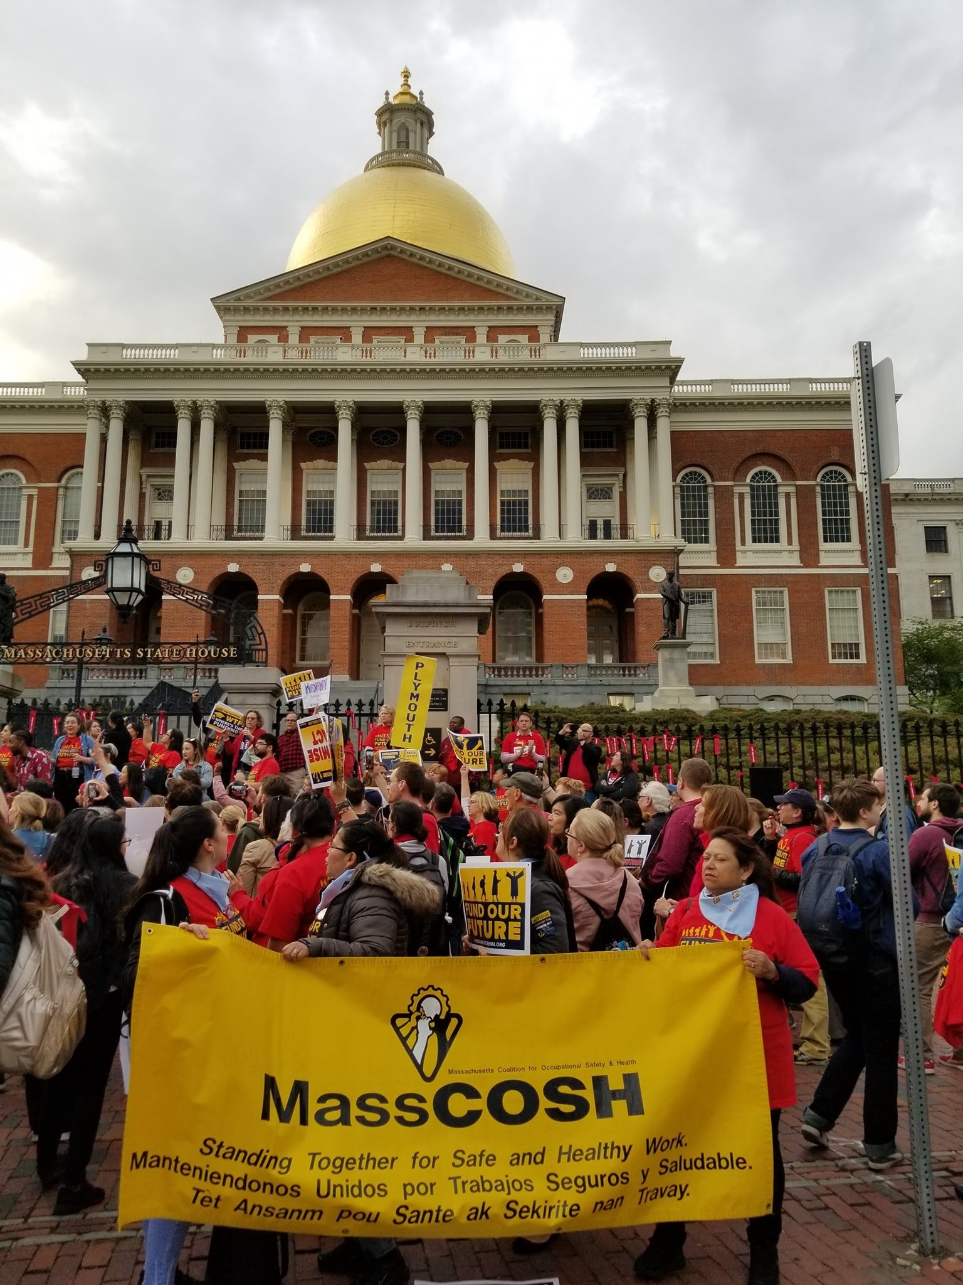
Massachusetts Coalition for Occupational Safety and Health
www.masscosh.org
1532B Dorchester Ave
Boston, MA 02122
617-825-SAFE(7233)
info@masscosh.org
FOLLOW US ON FACEBOOK, INSTAGRAM AND TWITTER
@MASSCOSH

Slide 33
Attorney General
Presenter: Amanda I. Merojón, Assistant Attorney General

Slide 34
Question & Answer

