Slide 1

Grant Seeking Basics - From Idea to Ask

Slide 2

What’s the Problem?

Slide 3
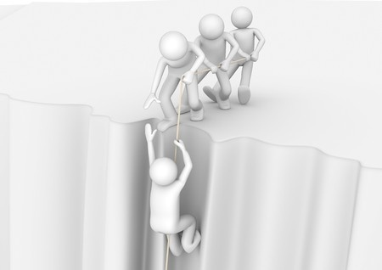
Who benefits?

Slide 4
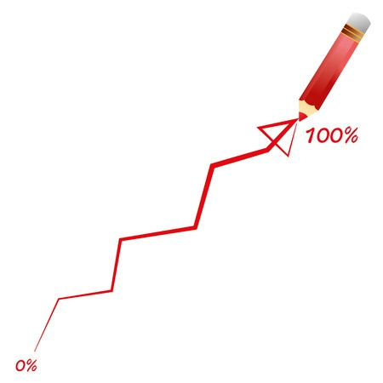
How will you measure your results?

Slide 5

When will you do the work?

Slide 6

Why you and why now?

Slide 7

How much will it cost?

Slide 8

How much do you need from us?

Slide 9

Why should I care?

Slide 10
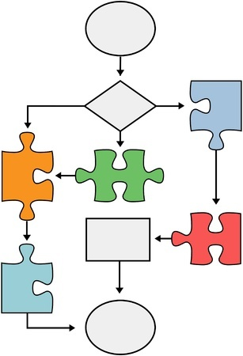
Process makes perfect

Slide 11
Differences between funding sources
Foundations
Corporations
Pros More of them Generally easy to apply Often less reporting requirements | Cons More competition Smaller awards Limited indirect (need to build out your budget to include) Limited to no feedback
Pros Can provide career of funding Generally more informal approach | Cons IP can be complex Hard to get in Interested in applied vs. basic

Slide 12
Resources
Funding: GrantForward PIVOT for funder research Foundation Center Grant Research Basics Guidestar (for 990 review) | Jobs: UMass Dartmouth Handshake Science Careers | Research resources: UMass Dartmouth Office of Research Administration

Slide 13

How we can help

Slide 14
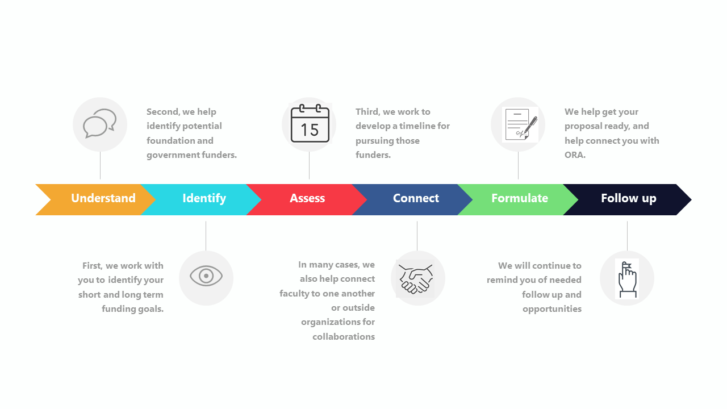
How we can help

Slide 15
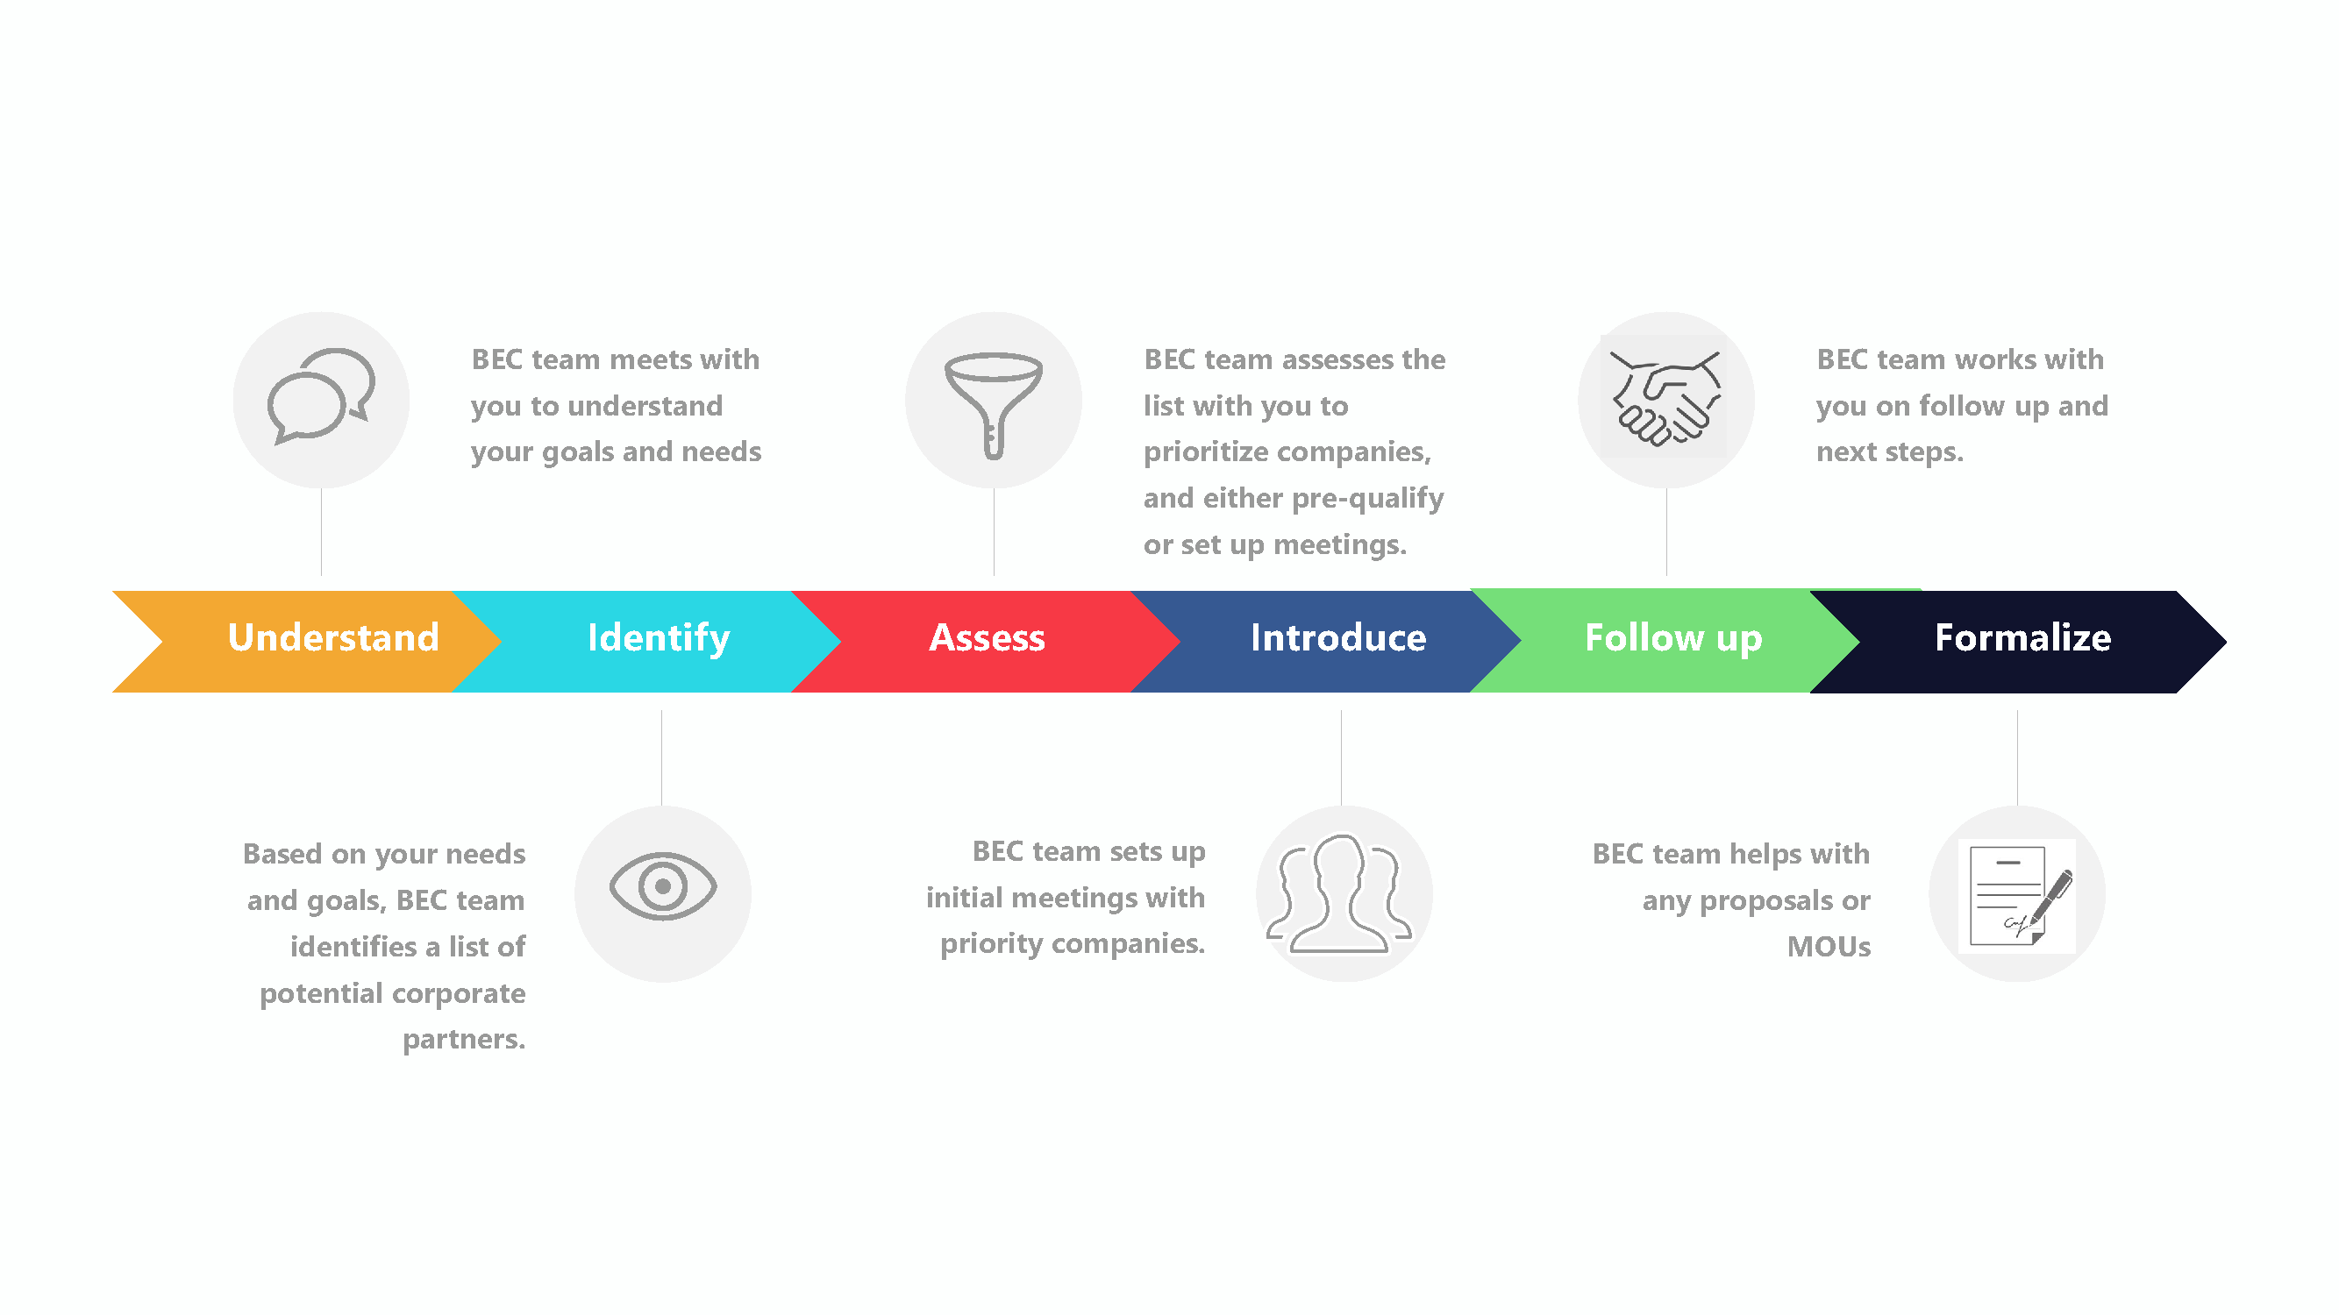
How we can help

Slide 16
Contact information
Michelle Plaud, Manager, Pre-Award Administration
mplaud@umassd.edu, 508-999-8509
Megan Hennessey-Greene, Director of Research Administration
mhennesseygreene@umassd.edu, 508-910-6958
Ben Jones, Director of Corporate Engagement and Institutional Partnerships
ben.jones@umassd.edu, 508-209-3711

