Slide 1

Tour My Course:
The Syllabus Edition
Dr. Jenny Howe
Dr. Jackie O'Dell
Dr. Alexis Teagarden
First-Year English Program
Department of English and Communication

Slide 2
Panel Introductions
& our syllabus journey

Slide 3
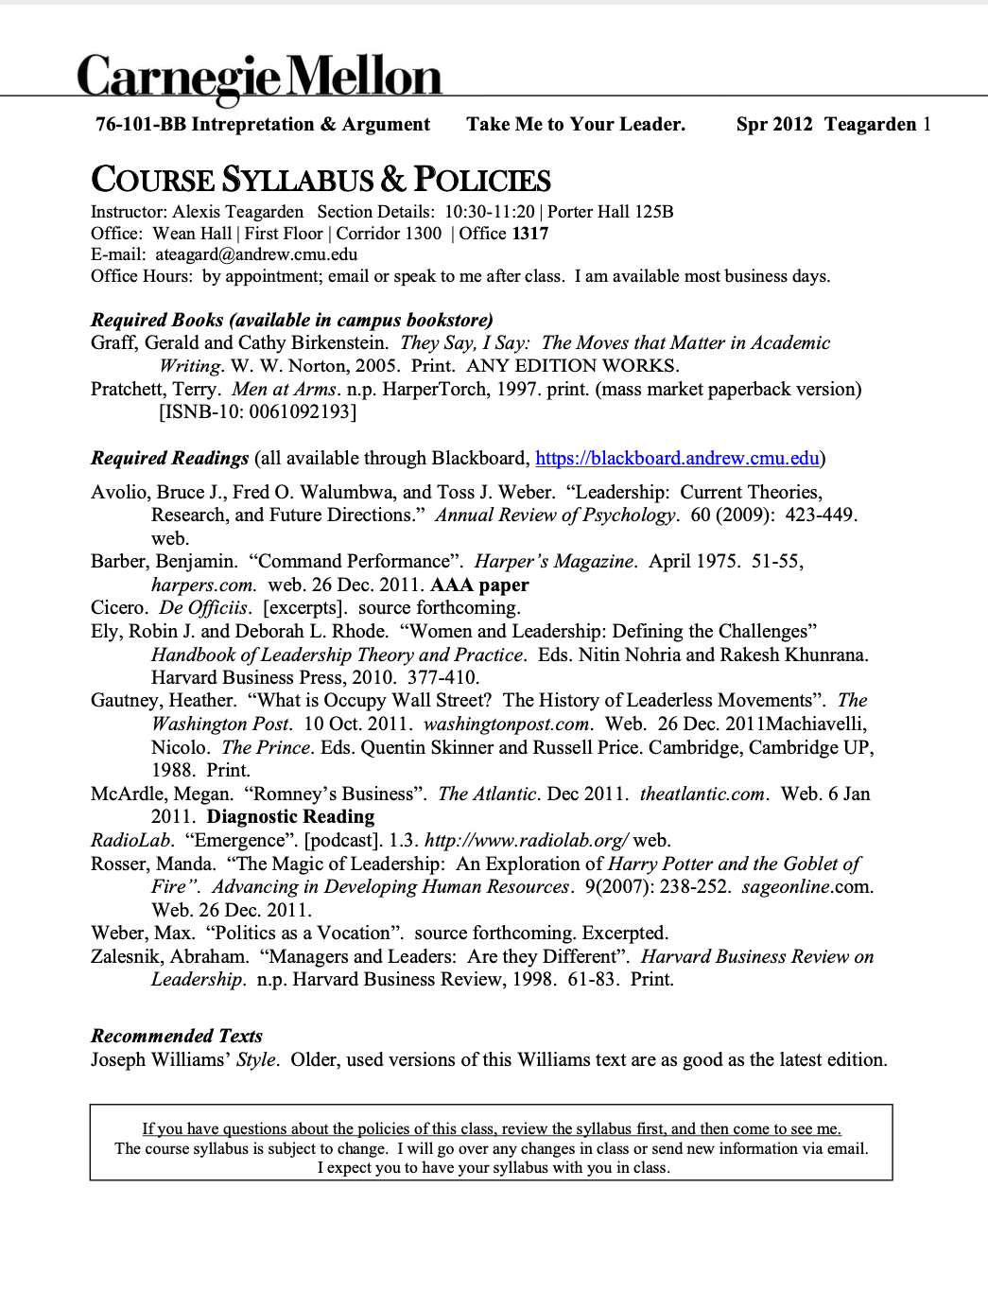
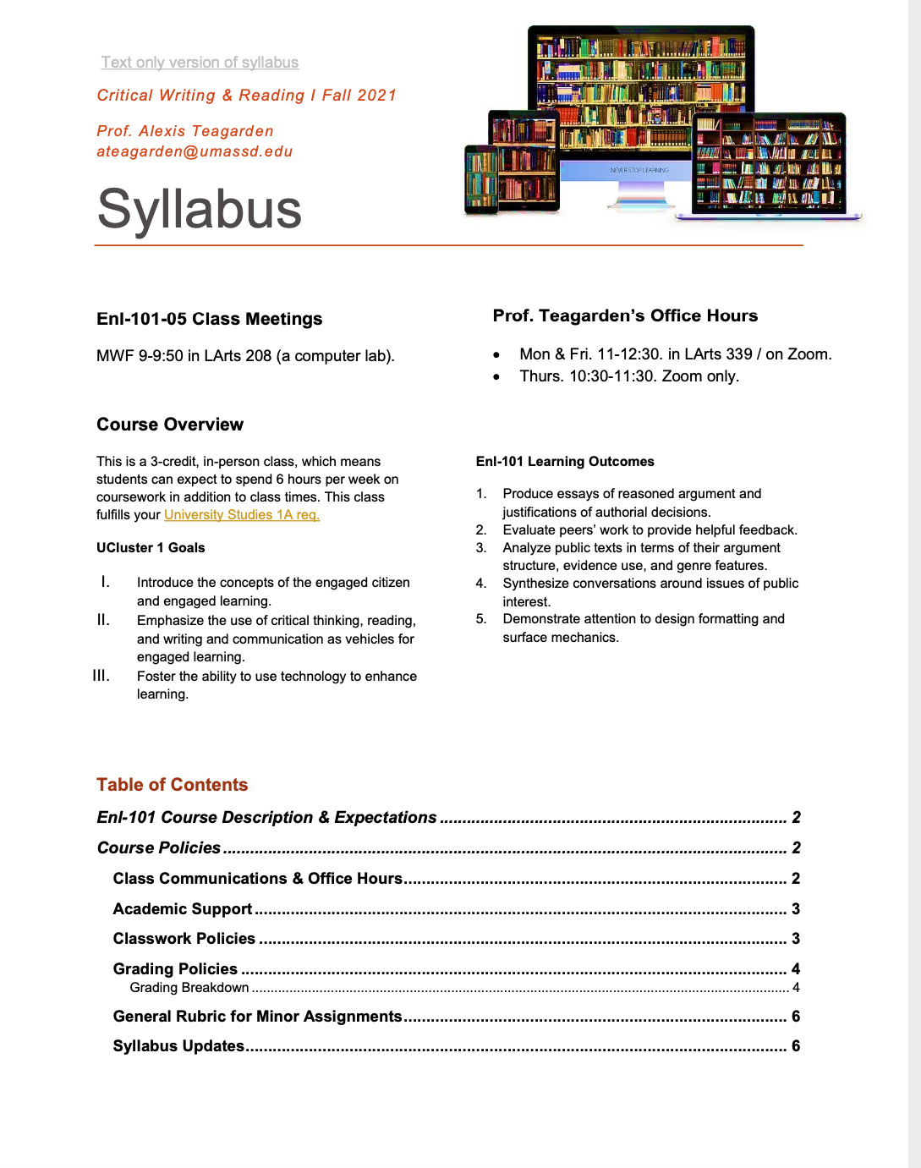
Alexis
Maximizing attention by minimizing clutter.
First-Year Writing
Spring 2012
First-Year Writing
Fall 2021

Slide 4
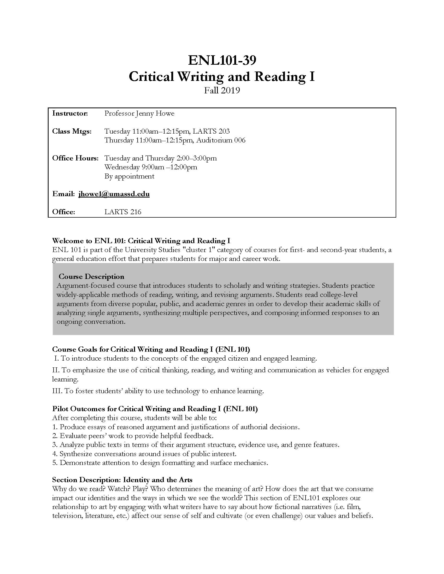
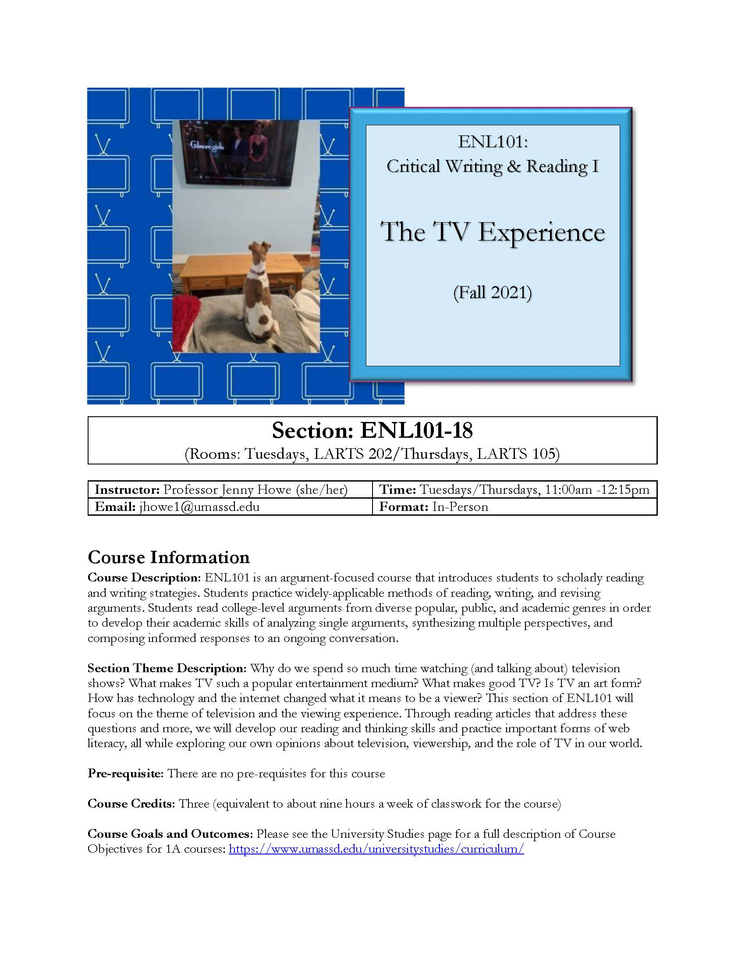
Jenny
Use color and streamlined layout to optimize clarity and invite engagement.
First-Year Writing
Fall 2019
First-Year Writing
Fall 2021

Slide 5
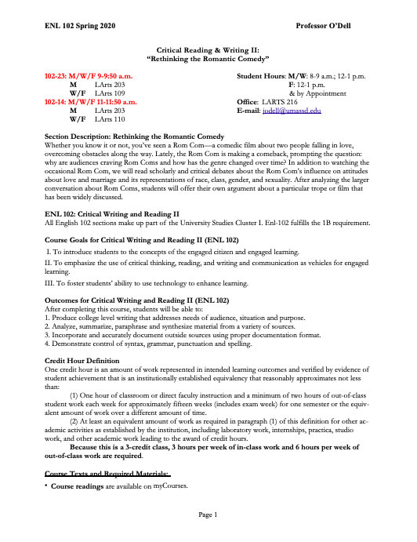
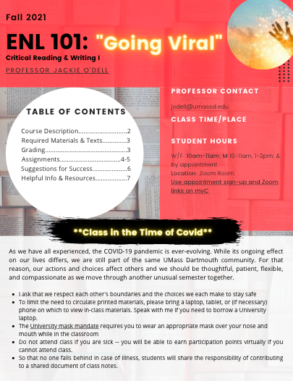
Jackie
Invite interactivity and set course tone through design
First-Year Writing
Spring 2020
First-Year Writing
Fall 2021

Slide 6
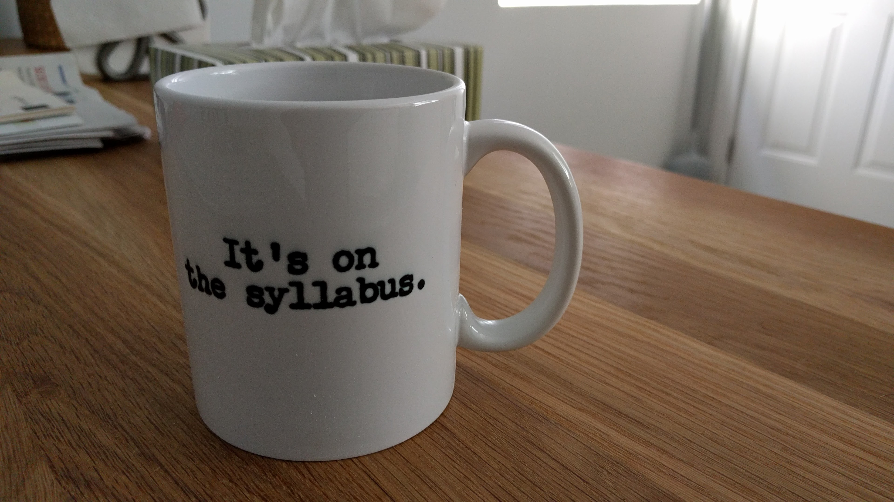
Premise 1
We want students to read the syllabus
(and who reads terms of service agreements?)
This Photo by Unknown author is licensed under CC BY-SA-NC.

Slide 7

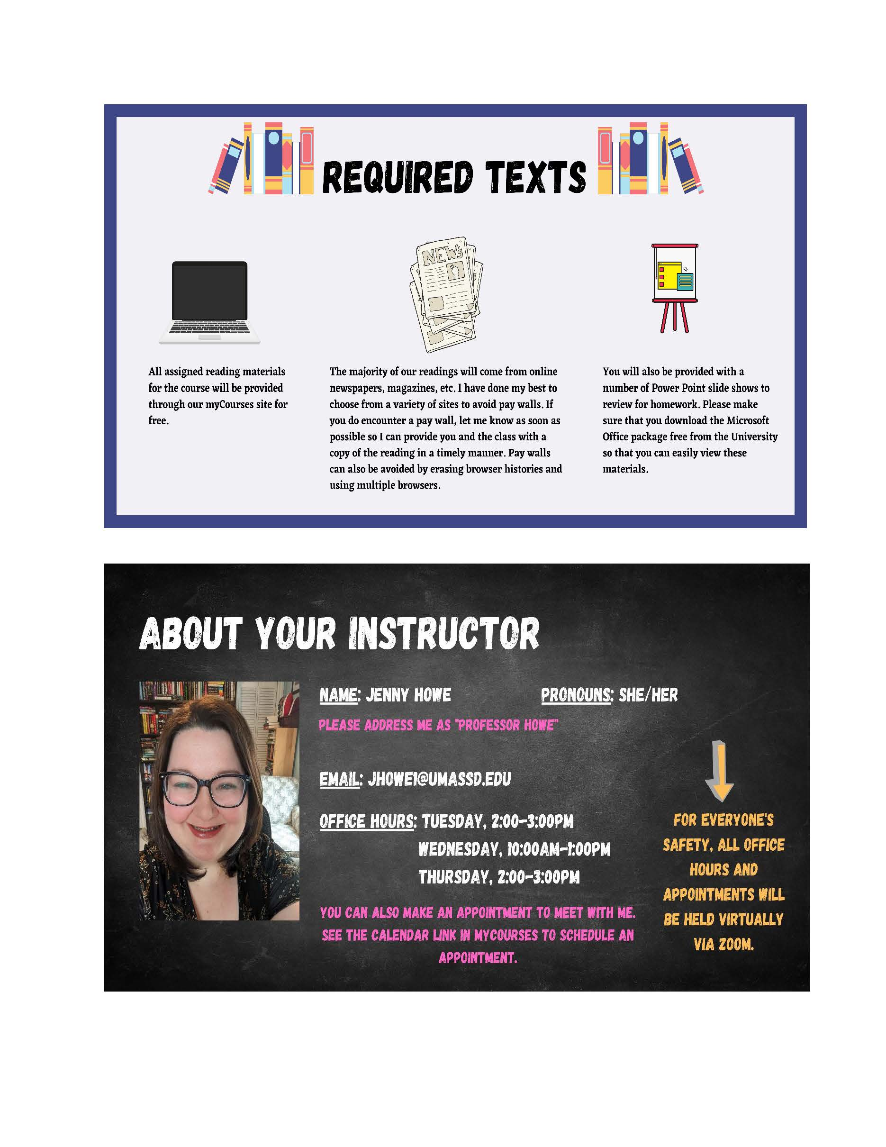
Tactic:
Create a visually interesting document
Notes:
Color, imagery, organization

Slide 8
Tactic:
Design to invite rather than intimidate
Notes:
Ways to invite: short lines/columns; clear dividers, subheadings and guides.

Slide 9
"Convincing students they will succeed at college-level work is difficult, particularly because professors' expertise can be immensely intimidating to students."
Rebecca C. Cox. The College Fear Factor: How Students and Professors Misunderstand One Another. Harvard UP, 2009 ​

Slide 10
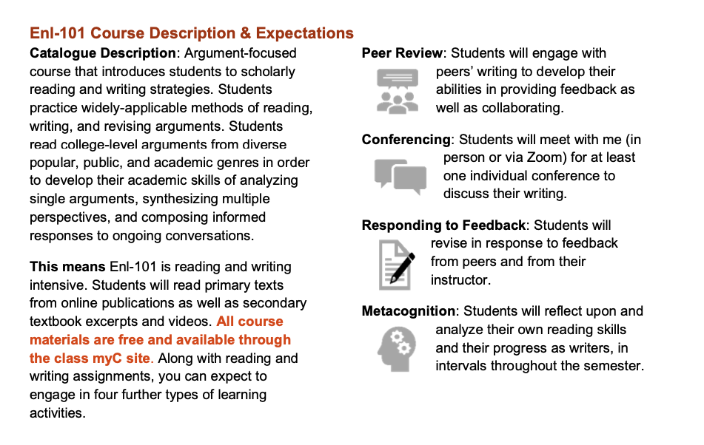
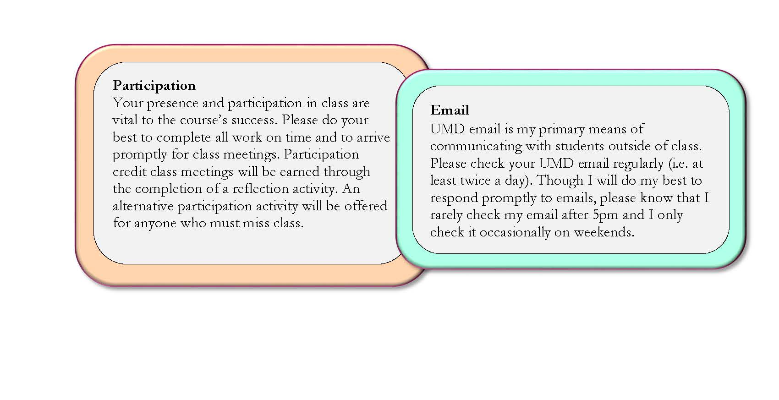
Tactic
Highlight key points with images or color
Notes:
Note intersection here between tone and readability; changes often can cover two goals, so these does not always mean a whole laundry list of changes are necessary; a few key shifts can make a lot of difference

Slide 11

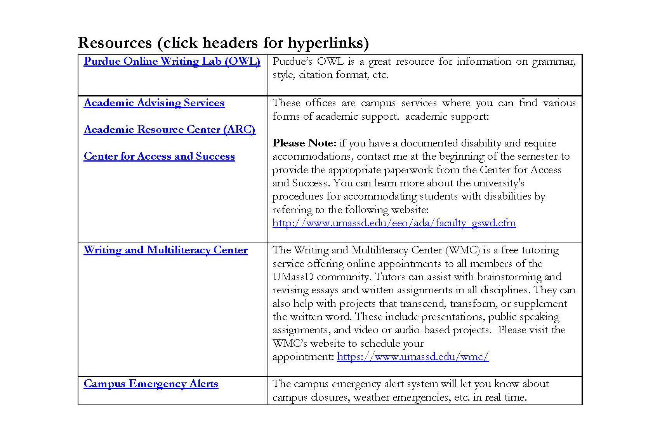
Tactic
Provide just the right amount of information (aka link, link, link)

Slide 12
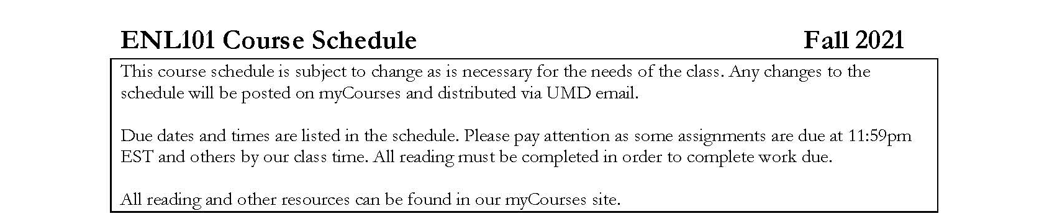
Tactic:
Demonstrate the syllabus is a living document

Slide 13

Premise 2
We set our class tone with the syllabus

Slide 14
Tactic:
Introduce yourself

Slide 15
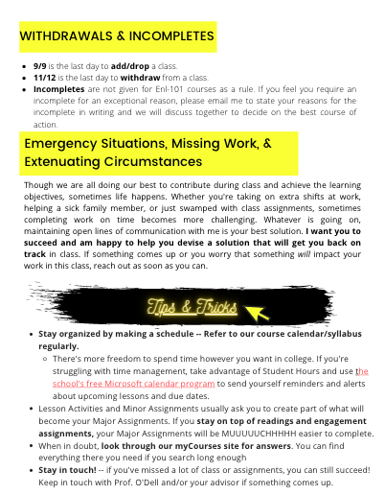
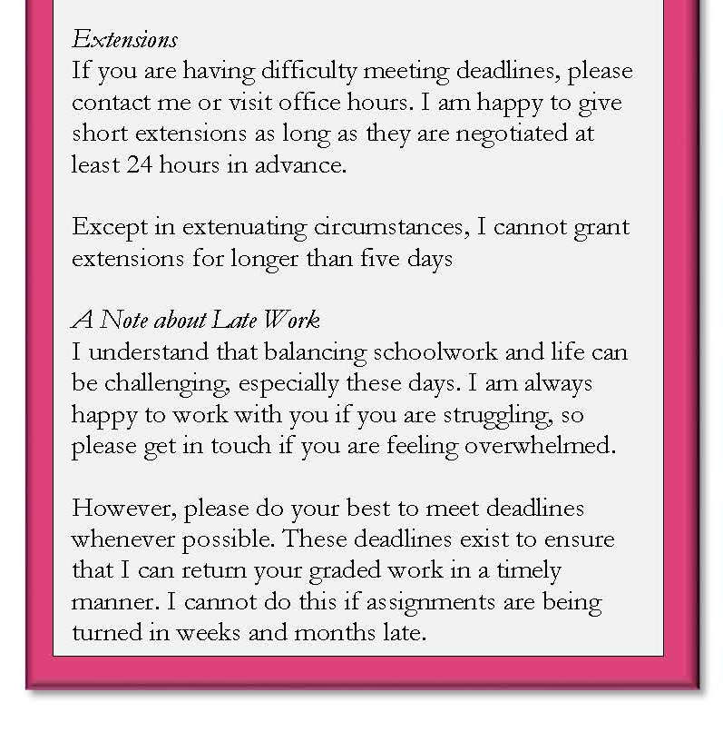
Tactic:
Communicate about challenges

Slide 16
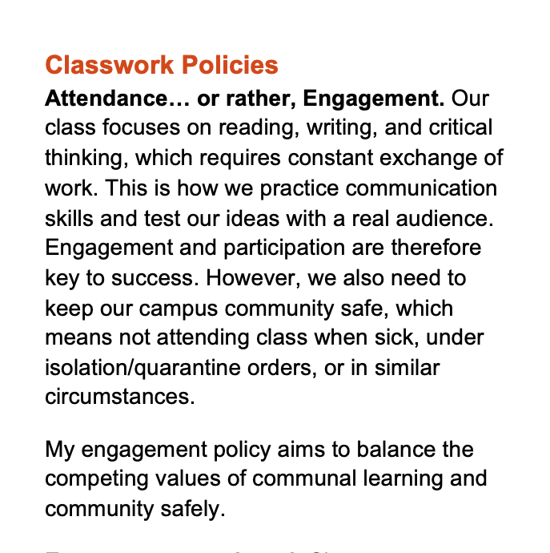
Tactic:
Write to your students like you talk to them in class.

Slide 17

Helpful resource
The Accessible Syllabus (a website) https://www.accessiblesyllabus.com/

Slide 18

Questions and Comments

