Slide 1

Effort Certification
What You Need To Know
Prepared by UMass Dartmouth
Office of Research Administration
October 2020

Slide 2

What is Effort Certification?

Slide 3
Effort Certification Defined
Effort certification is the process by which Principal Investigators (PIs) certify that the amount of salary charged and/or cost shared to a sponsored project reasonably represents the percentage of total effort spent on the project during the certification period. Effort certification is not an exact science, nor is it based on a 40-hour workweek. Sponsors recognize that reasonable estimates are all that is expected.
An effort card shows the distribution of salary charged to all funding sources during the fiscal period as a percentage of the total annual salary. Any salary expensed to cost share companion accounts appears on the effort card and certified at the same time as sponsored effort. Non-sponsored funds are rolled up and certified in total.
Effort is
proposed
Salary is
Charged
Effort is certified

Slide 4
How is Effort Determined?
Effort is NOT based on a 40-hour work week
Effort is based on 100% of the activities for which you are compensated by UMass Dartmouth
These activities are divided into:
Sponsored project activities
Non-sponsored activities, such as:
Administration, including duties as Chair, Dean, etc.
Teaching
Research without external funding
Public service and outreach
Serving on University Committees
Attending general departmental faculty meetings

Slide 5
What Counts in Your 100% Effort?
Sponsored Activity
This is your effort on:
Federal grants or contracts (e.g. NSF, DOD, NOAA)
Non-federal research projects (e.g. a foundation grant or industry sponsored clinical trial)
Activities you can allocate to a sponsored project include:
Writing progress reports; holding a meeting with lab staff; presenting research results at a scientific conference; reading scientific journals to keep up to date with the latest advances in the project topic area... even if your salary is not completely paid by the sponsor (i.e. salary cost sharing)

Slide 6

Activities NOT Included in Your 100% UMass Dartmouth Effort
Consulting, lectures, presentations, peer review of manuscripts, scientific review panels, advisory activities, or leadership in professional societies for non-UMass Dartmouth entities regardless of any compensation received for those activities
Amounts paid as bonuses or retroactive contractual salary increases paid after the certification period is closed
Volunteer public service not directly related to UMass Dartmouth efforts
Unpaid absences

Slide 7
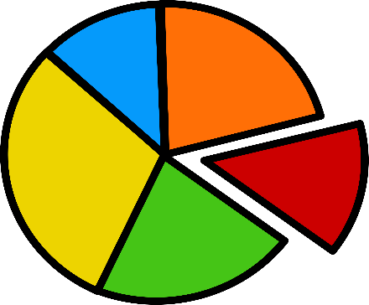
Examples of Effort Determination
If you have a quarter-time job, your 100% effort corresponds to everything you do for that job. So, for you, 0.25 FTE = 100% UMassD Effort
If you work 40 hours a week, your 100% effort corresponds to all the activities for which the UMass compensates you during that time. Here, 40 hours = 100% UMASS effort
If you work and were paid for one month during the Summer on your project and do not work or are paid to do anything else, your effort for the Summer on your project is 100%

Slide 8

Keep In Mind
Effort certification should be a reasonable estimate of how time was expended.
The Uniform Guidance Subpart E §200.430(c) states, “It is recognized that teaching, research, service and administration are often inextricably intermingled in an academic setting. When recording salaries and wages charged to Federal awards for IHEs (Institutions of Higher Education) a precise assessment of factors that contribute to costs is therefore not always feasible, nor is it expected.”

Slide 9
Institutional Base Salary
The total base compensation an individual receives annually from the campus, whether the individual’s time is spent on research, teaching, or other activities.
IBS includes:
compensation for instruction
public service
research, and/or other activities
IBS excludes:
fringe benefit payments
reimbursed expenses
temporary, supplemental compensation for incidental work
income earned outside of duties to the institution
any portion of compensation deemed to be at-risk.
IBS may or may not include additional payment for administrative duties per each campus’ written policy.
EFFORT CERTIFICATION IS BASED ON IBS

Slide 10
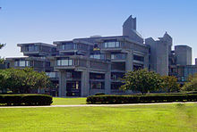
Why Certify? And consequences if we don’t…

Slide 11
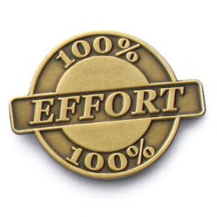
Why Do We Have Effort Certification?
Effort reporting is a requirement by the Uniform Guidance for institution receiving sponsored research funding via federal grants and contracts.
Uniform Guidance Subpart E §200.430 contains the federal regulatory requirements for internal controls over certifying time expended on sponsored projects.

Slide 12
Risk of Non-compliance
Severe penalties and funding disallowances could result from inaccurate, False Claims, incomplete, or untimely effort reporting.

Slide 13

Who Must Certify?
Faculty are required to certify their own effort reports and are required to certify the effort reports of their research staff working on their sponsored project(s) unless they have the employee sign their own.
The certification is attesting that effort paid or contributed for a time period matches the effort expended for the time period being certified. Hence, summer salary may not be used to compensate for work performed during the academic year.
In cases where the employee or principal investigator is not available, a responsible official may certify the effort provided that s/he can document the basis for verifying that the actual work was performed.

Slide 14

When Do We Certify?
UMass Dartmouth certifies effort annually.
The Certification period will be the Academic year ( September to August) and include the Fall, Spring and Summer semesters).
You will receive a system generated email from ECC when the certification period open. Expect to receive in early November.

Slide 15

How Do I Certify My Effort?
The University of Massachusetts system certifies effort using Employee Compensation Compliance (ECC) system: 1. Effort Commitment and payroll data are uploaded from PeopleSoft systems into ECC on a bi-weekly basis. 2. Effort certification cards are pre-populated with this information. 3. This information is reviewed by the certifier, corrected as needed and then certified. 4. The certification is attesting that effort paid or contributed for a time period matches the effort expended for the time frame.
5. For instructions on using ECC, refer to the ECC Training Video link and the PowerPoint Effort Certification How To on the ORA website at https://www.umassd.edu/research/grants/effortcertification/.

Slide 16
What Do I Do The Rest Of The Year?
Keep track of your effort.
Review your monthly reports generated and sent to you by ORA for any errors or omissions.
Work with your Grant Manager to resolve any discrepancies as soon as detected.
Since we are only certifying effort once a year we want to be PROACTIVE - not REACTIVE

Slide 17

Note: Information was taken from the UMass Dartmouth ORA website for this presentation

